Slide 1
\ Upper Colorado River Commission System Conservation Pilot Program (SCPP) SCPP 2024 Kick-off Webinar
OCTOBER 27, 2023

Slide 2
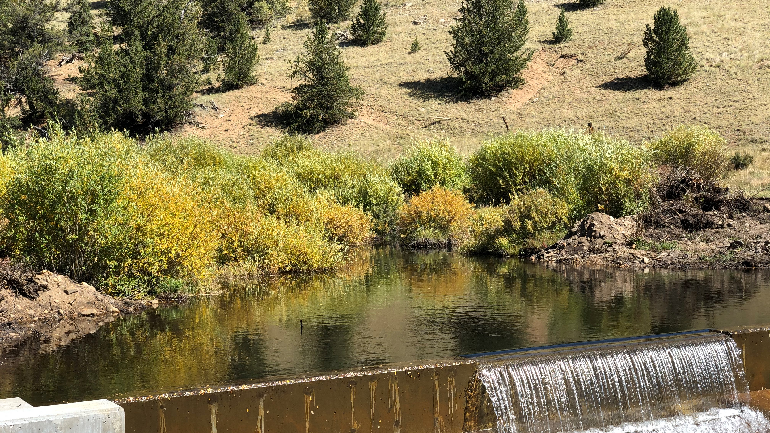
SCPP in 2024 Kick-off Webinar Goals:
Provide a summary of Lessons Learned from 2023 Process
Identify approaches to improve process for 2024
Share key dates for 2024 SCPP process
Share compensation plan for 2024 SCPP process
Identify 2024 SCPP review and approval process
Outline how to obtain more information and follow up information
Identify next steps in the 2024 SCPP process

Slide 3
How to Get More Information about SCPP in 2024
Provide your questions in the chat box during the webinar. Questions will be addressed in a FAQ posted on the UCRC SCPP in 2024 webpage next week (http://www.ucrcommission.com/system-conservation-pilot-program-in-2024/)
Contact UCRC via email at scpp@ucrcommission.com
Contact your Upper Division State contact or Wilson Water Group (WWG - UCRC contractor for 2024 SCPP) with questions
Colorado – Amy Ostdiek
New Mexico – Ali Effati
Utah – Lily Bosworth
Wyoming – Jeff Cowley
WWG – Brenna Mefford
Targeted Outreach to Tribes and others
Additional Outreach by States
Additional UCRC webinars
November 9, 2023
December 7, 2023

Slide 4
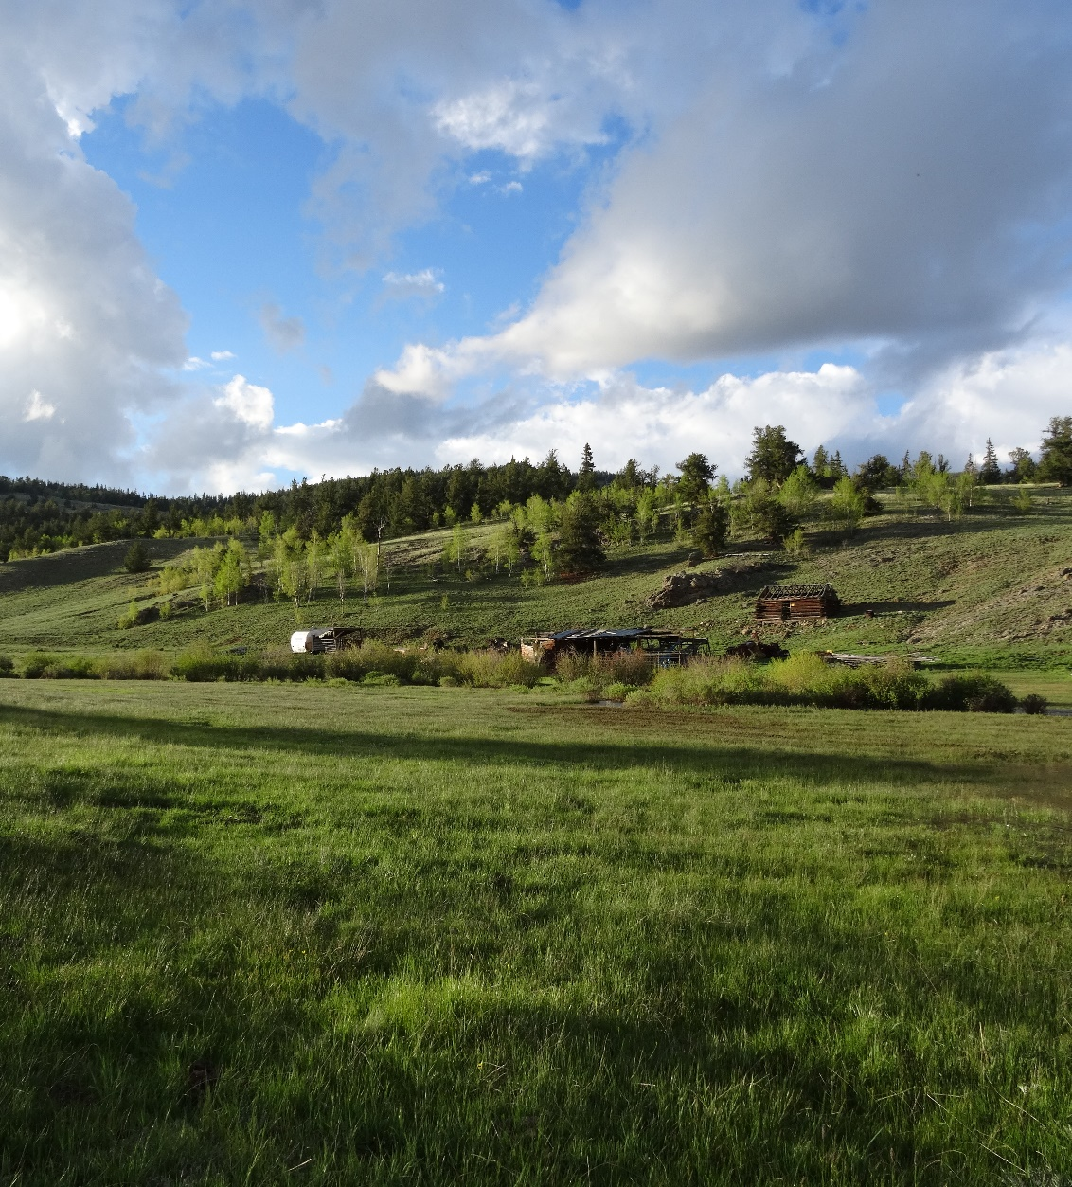
Lessons Learned – Five Themes
Timing – Start processes in fall (early October)
Pricing – Provide firm, fixed pricing at the outset (partnership & concurrence from BOR)
Conserved Consumptive Use (CCU) – Provide clarity and transparency on CCU calculation and the basis of payments
Consistent and Clear Messages – Persistent and consistent messaging to reduce confusion and mischaracterizations, avoid conflicting statements
Greater Transparency on Approach, Purpose, and Review – Provide FAQs and map review processes within UDS
Lessons Learned Report available: http://www.ucrcommission.com/system-conservation-pilot-program-in-2024/

Slide 5
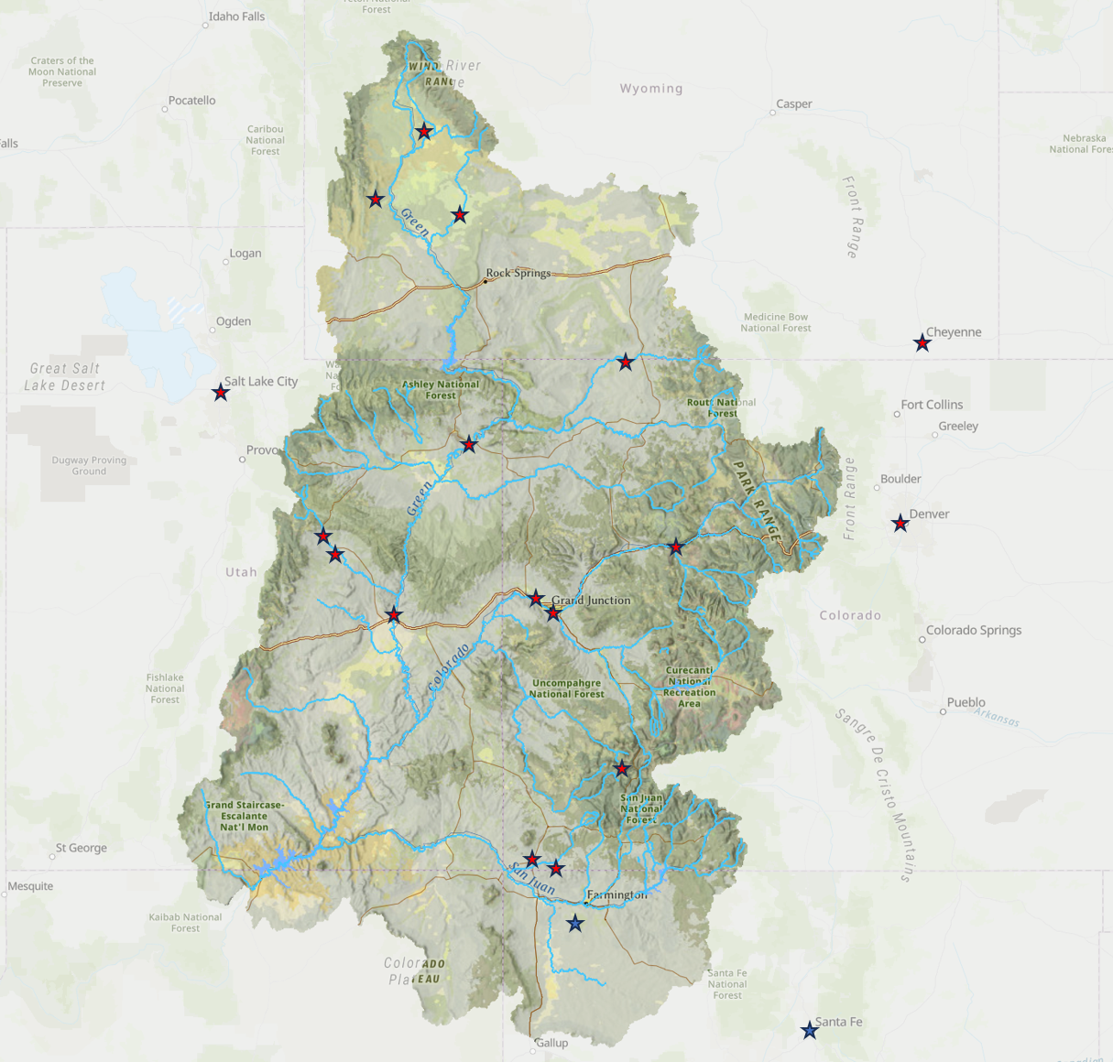
Lessons Learned Partner Engagement
= In-Person Visit
= Virtual Visit
Met with ~30% of 2023 participants
Met with some who didn’t participate in 2023
Tribes
NGOs
BOR
States

Slide 6
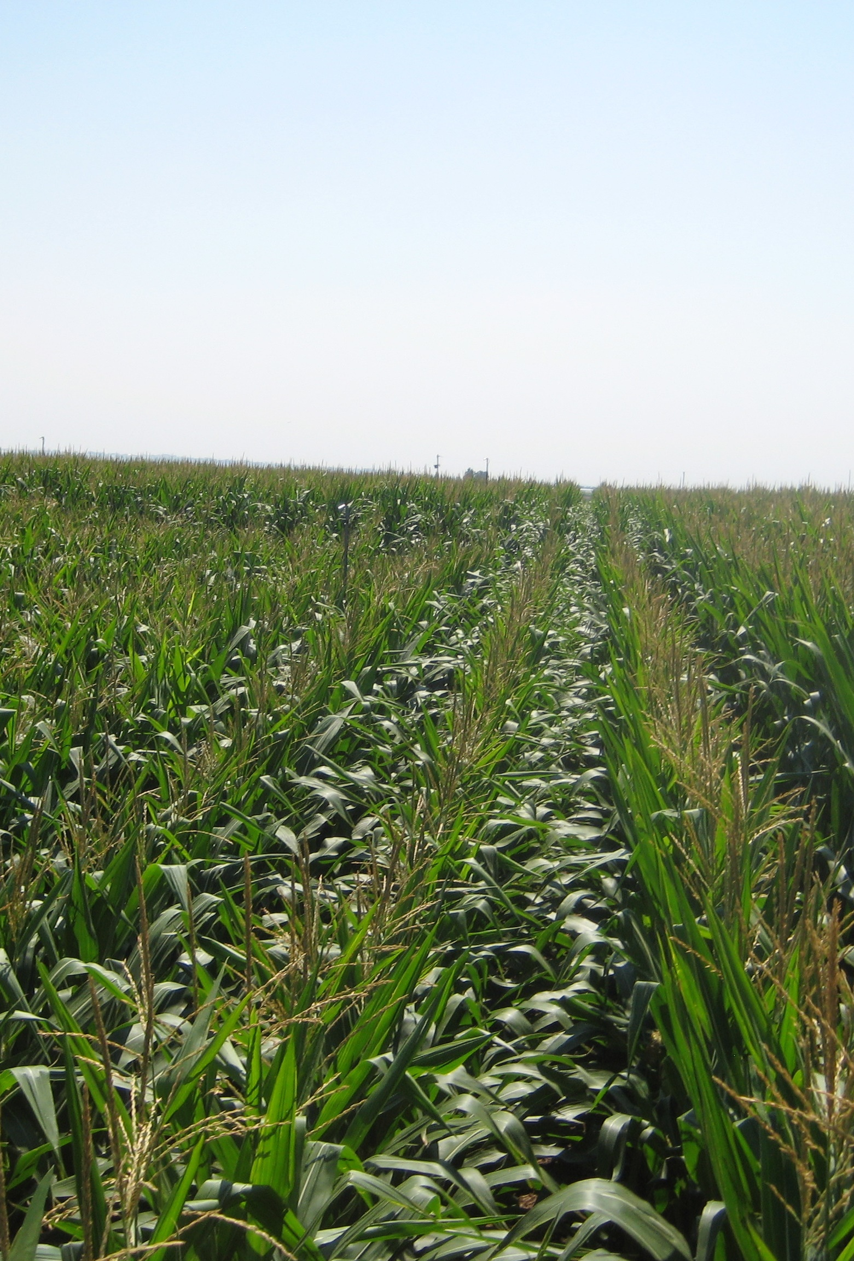
Messages from SCPP Participants
SCPP provides a way to lower risks to try new, innovative strategies and approaches to adapt their production to a drier and uncertain water supply future.
Participants seek longer-term programs that provide resiliency through innovation, infrastructure investments, and new water management tools.
Participants want to protect vibrant but fragile local economies. They prefer continued production with lower water use over large-scale fallowing.
Their water and production are equally valuable. They do not see any of their land or production as “marginal” or “less than” anyone else, locally or across the Basin.

Slide 7
UCRC Commissioners Selected a Narrower Focus for 2024 SCPP
Options Considered for 2024 SCPP
No 2024 SCPP Program
Maximize 2024 SCPP – implement recommended SCPP improvements with the goal of maximizing 2024 Conserved Consumptive Use (CCU)
Narrow 2024 SCPP to projects that implement recommended SCPP Improvements AND
Inform Demand Management feasibility questions
Support Innovation & Local Resiliency resulting in water conservation

Slide 8
2024 SCPP Timeline Overview
10/27/2023 Kick-off Webinar & Application materials available on UCRC website
Follow Up Meetings and targeted outreach
November UCRC webinar – November 9, 2023
December UCRC webinar – December 7, 2023
State meetings
Targeted outreach
12/18/2023 Applications due to UCRC
12/19/2023 – February 2024 State review processes and Bureau of Reclamation (BOR) participation
February 2024 - Upper Division States joint review through UCRC
February 2024 - UCRC Special Meeting to consider 2024 Projects
March 2024 - Execute System Conservation Implementation Agreement & Implement Projects

Slide 9
Lessons Learned – Five Themes
Timing – Start processes in fall (October)
Pricing – Provide firm, fixed pricing at the outset (partnership & concurrence from Bureau of Reclamation)
Conserved Consumptive Use (CCU) – Provide clarity and transparency on CCU calculation and the basis of payments
Consistent and Clear Messages – Persistent and consistent messaging to reduce confusion and mischaracterizations, avoid conflicting statements
Greater Transparency on Approach, Purpose, and Review – Provide FAQs and map review processes within Upper Division States
Lessons Learned Report available: http://www.ucrcommission.com/system-conservation-pilot-program-in-2024/

Slide 10
2024 Compensation By State and Project Type
State | Project Type | 2024 All Project-Type Approaches | 2023 USBR Price ($/af) | 2024 SCPP Method ($/af)
Colorado | Full-Season Fallow | All Crops | $ 462.00 | $ 509.00
 | Split-Season/Crop-Switch | Same as above, * by CCU ac-ft/ac | $ 200.00 | $ 509.00
 | Reservoir Storage | 2023 SCPP pricing | $ - | $ 150.00
 | M&I |  | $ - | $ Case-by-case
New Mexico | Full-Season Fallow | All Crops | $ 260.00 | $ 300.00
 | Split-Season/Crop-Switch | Same as above, * by CCU ac-ft/ac | $ - | $ 300.00
 | Reservoir Storage | 2023 SCPP pricing | $ - | $ 150.00
 | M&I |  | $ - | $ Case-by-case
Utah | Full-Season Fallow | All Crops | $ 595.00 | $ 506.00
 | Split-Season/Crop-Switch | Same as above, * by CCU ac-ft/ac | $ 250.00 | $ 506.00
 | Reservoir Storage | 2023 SCPP pricing | $ 150.00 | $ 150.00
 | M&I |  | $ - | $ Case-by-case
Wyoming | Full-Season Fallow | All Crops | $ 513.00 | $ 492.00
 | Split-Season/Crop-Switch | Same as above, * by CCU ac-ft/ac | $ - | $ 492.00
 | Reservoir Storage | 2023 SCPP pricing | $ - | $ 150.00
 | M&I |  | $ 163.00 | $ Case-by-case

Slide 11
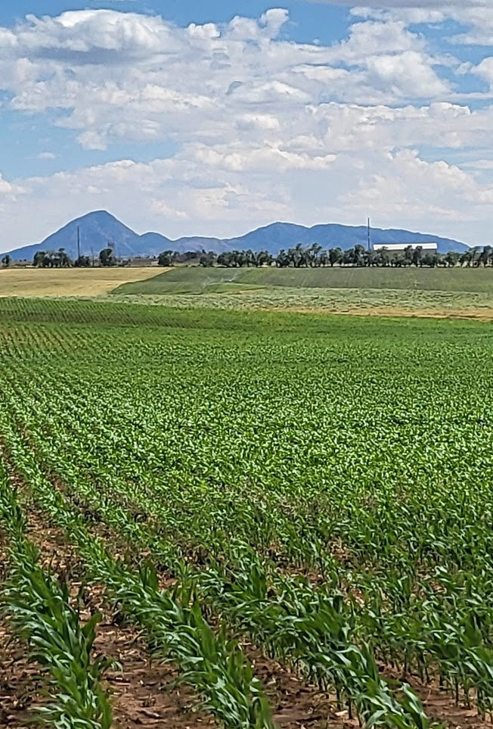
2024 Application Process Overview
Online application (http://www.ucrcommission.com/draft-scpp-2024-application-form/)
Includes ability to enter Multi-Participant projects
Requires pre-application discussion with Wilson Water Group
Calculation of Conserved Consumptive Use
Project description relative to key focus:
Informing Demand Management feasibility questions
Water Conservation Innovation & Local Drought Resiliency
Important to note:
Irrigation projects must include a minimum of 40 acres
Information may become subject to public disclosure
Application can be denied by States, UCRC, or Reclamation for any reason

Slide 12
On-Line Application Overview

Slide 13
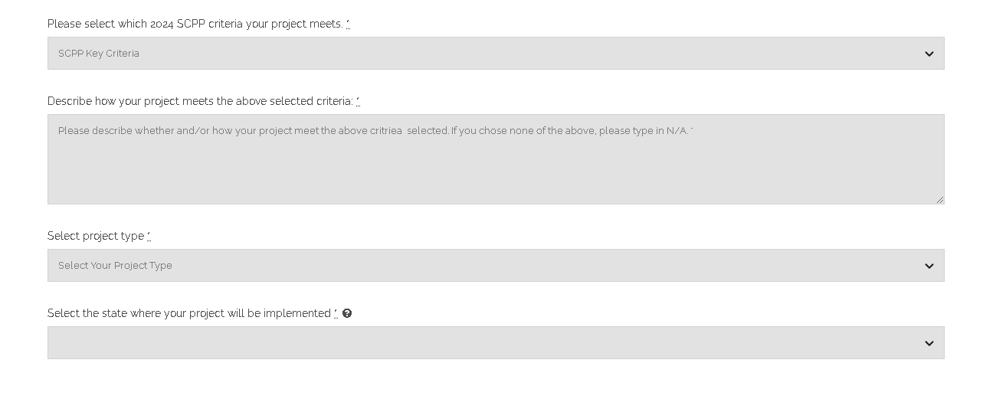
On-Line Application Overview

Slide 14
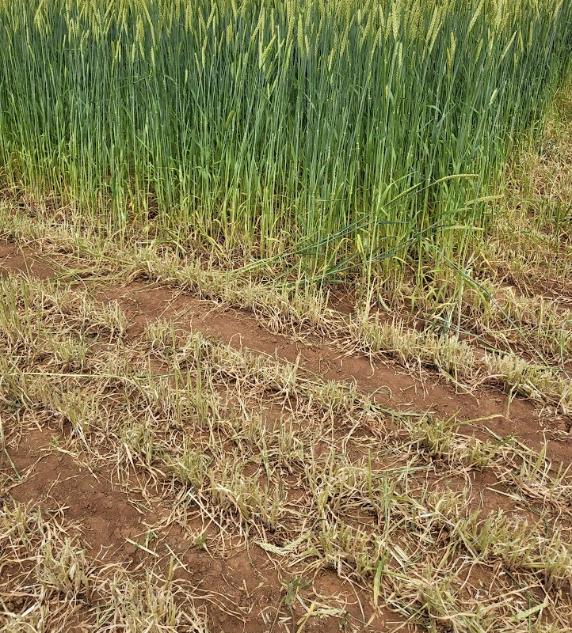
2024 SCPP Review Process Timeline
10/27/2023 – 12/18/2023 Application process
Includes pre-application discussions on Conserved Consumptive Use and Project Description
12/18/2023 Applications due to UCRC
12/19/2023 – February 2024 State review processes, BOR participation
State water management and water rights agencies - review each application for consistency with State laws and policies, and potential adverse impacts
BOR - review for consistency with federal laws and regulations including NEPA
WWG and UCRC – provide support as necessary
Upper Division States through UCRC - jointly review applications after State reviews
February UCRC Special Meeting to consider 2024 SCPP projects
March execute SCIAs and implement projects

Slide 15
Colorado Review Summary
CWCB and DWR review of applications.
Applications meeting minimal requirements and passing fatal flaw review will be shared with parties who sign-up to receive information. They will have an opportunity to comment on applications.
CWCB Board will have an opportunity to approve SCPP as a state-approved conservation program.

Slide 16
New Mexico Review Summary
New Mexico Interstate Stream Commission (NMISC) reviews any NM applications for consistency with State law, policies, and impacts
NMISC reaches out to the Office of State Engineer for review of the validity of the water rights at issue

Slide 17
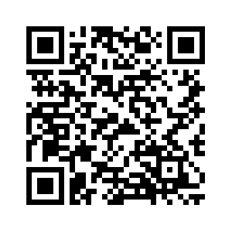
Utah Review Summary
Colorado River Authority of Utah reviews proposals for completeness, clarity, and alignment with SCPP Selection Criteria
Utah Division of Water Rights verifies water rights information provided is complete and correct, and that the project activity complies with Utah regulations
No water rights holder consultation with the Utah Division of Water Rights is required for SCPP
https://cra.utah.gov/
system-conservation-pilot-program/

Slide 18
Wyoming Review Summary
State Engineer’s Office provides review and answer questions as applicants start the process.
Water management/water rights reviews for consistency with State law, policies and impacts.
Please feel free to contact Jeff Cowley or Charlie Ferrantelli with questions.

Slide 19
Additional Outreach Summary
UCRC Outreach Webinar – November 9th
UCRC Outreach Webinar – December 8th
State Outreach Approaches…

Slide 20
Colorado Outreach Summary
Public Outreach
Outreach to Colorado Basin Roundtables and IBCC
Webinar for Colorado water users on Monday, November 13
Will be recorded for asynchronous viewing
Public Comments on Applications
Public process for reviewing SCPP applications
To join list, email dnr_ColoradoSCPP@state.co.us by 12/18
Email address for all SCPP inquiries:
dnr_ColoradoSCPP@state.co.us

Slide 21
New Mexico Outreach Summary
NMISC will send out email blasts to the New Mexico stakeholders to encourage them to consider submitting applications
NMISC will meet with the New Mexico stakeholders on November 15th
NMISC will schedule additional virtual or in-person outreach meetings with stakeholders if needed

Slide 22
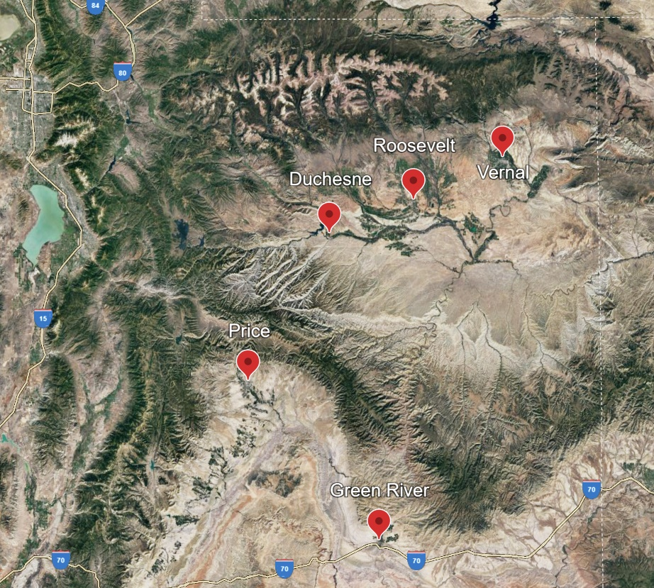
Utah Outreach Summary
https://cra.utah.gov/
system-conservation-pilot-program/
Webinar: Friday, November 3, 2023, 12 PM
Green River City Hall: Monday, November 6, 2023, 6 PM
Price USU Eastern: Tuesday, November 7, 2023, 6 PM
Vernal Regional DNR Office: Wednesday, November 8, 2023, 6 PM
Roosevelt USU Uintah: Thursday, November 9, 2023, 4 PM
Duchesne Central Utah Water Conservancy District Office: Thursday, November 9, 2023, 6 PM
Webinar: Friday, December 1, 2023, *TIME TBD*

Slide 23
Wyoming Outreach Summary
WY State Engineer’s Office will be available by phone or email for questions.
WY State Engineer’s Office will hold at least one public webinar to share information and answer questions about SCPP 2024.
WY State Engineer’s Office will meet with WY Colorado River Advisory Committee to share information and answer questions about SCPP 2024.

Slide 24
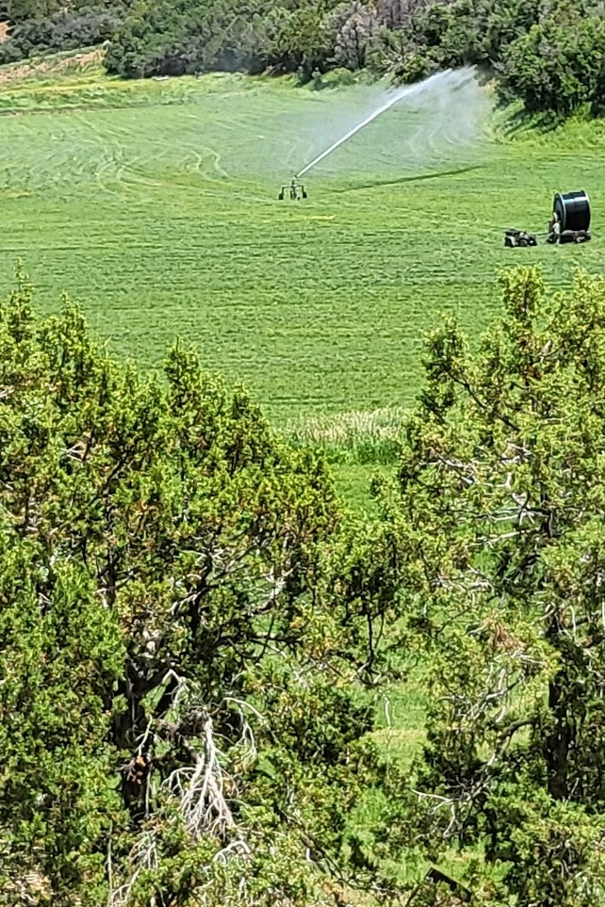
Next Steps in the Application Process
Review application materials on UCRC webpage
Contact WWG for pre-application discussion
Applications due 12/18/2023
Decisions in February 2024
Execution of agreements and implement projects in March 2024

Slide 25
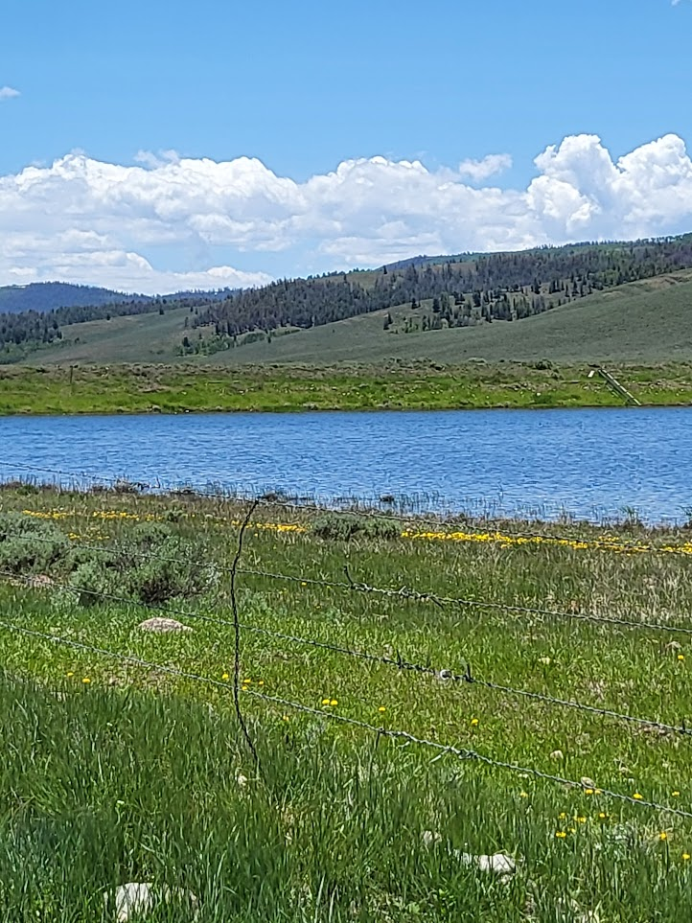
Contacts & Application Materials
Application materials…
http://www.ucrcommission.com/draft-scpp-2024-application-form/
Contact WWG for pre-application discussion
Brenna Mefford or Stephen Foster – 303-953-1923, scpp@ucrcommission.com
Colorado
Amy Ostdiek - amy.ostdiek@state.co.us
New Mexico
Ali Effati - Ali.Effati@ose.nm.gov
Utah
Lily Bosworth - lbosworth@utah.gov
Wyoming
Jeff Cowley - Jeff.Cowley@wyo.gov
UCRC
UCRC Staff - scpp@ucrcommission.com

