Slide 1
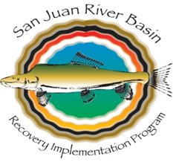
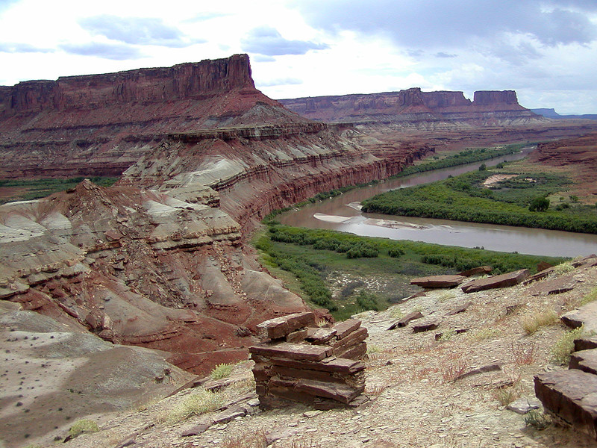
U.S. Fish and Wildlife Service
Briefing to the
Upper Colorado River Commission
May 19, 2020

Slide 2
Partners:
The key to Programs’ success

Slide 3
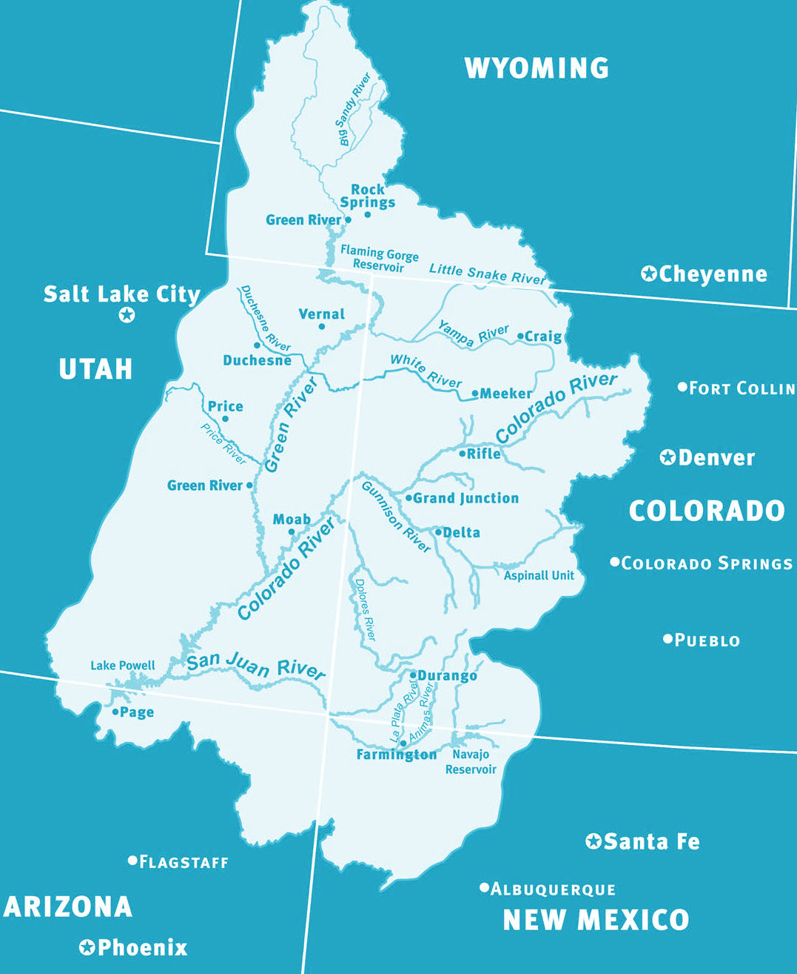
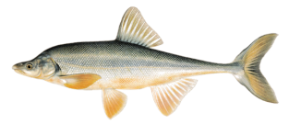
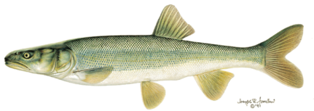
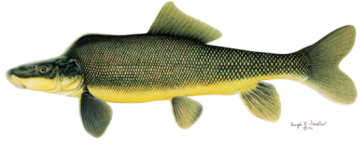
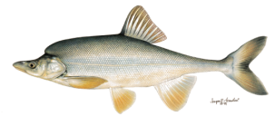
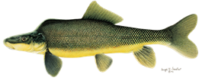
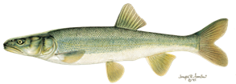
Upper Colorado River Basin

Slide 4
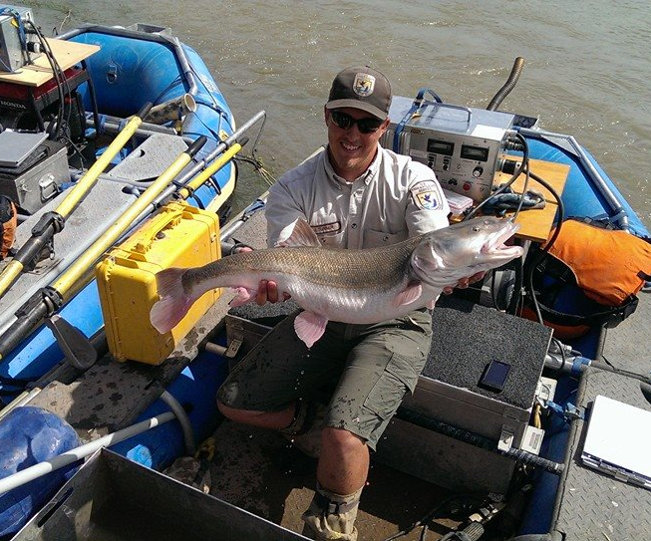
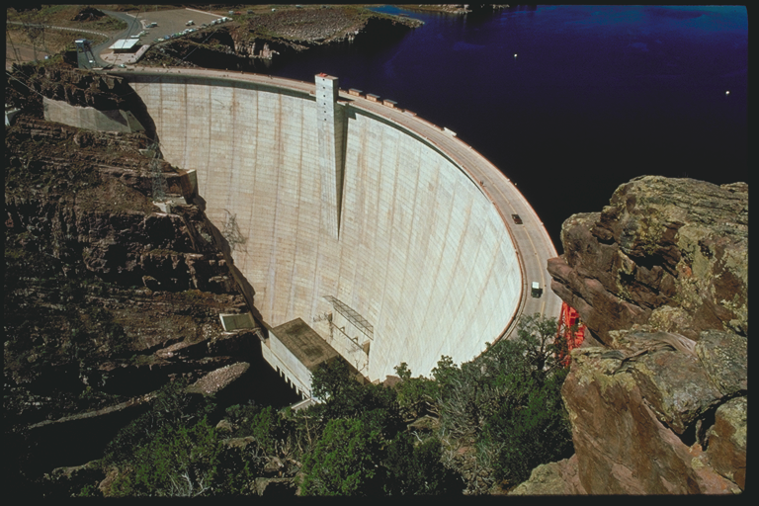
Recover the endangered fish as water development proceeds in compliance with the Endangered Species Act, state water law, interstate compacts, and federal trust responsibilities to tribes.
Recovery Programs’ Goal

Slide 5
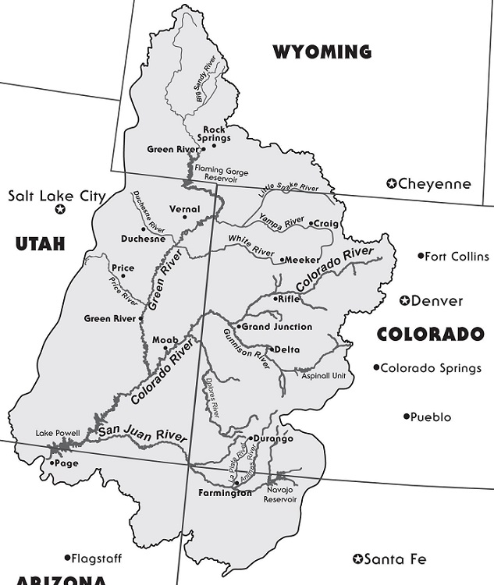
2020 Forecasted Runoff (Apr-Jul)
as Percent of Longterm Average
Green River Flaming Gorge Inflow
92%
Yampa @ Deerlodge
104%
White @ Watson
80%
Duchesne @ Randlett
82%
Colorado @ Cameo
85%
Gunnison @ GJ
58%
San Juan @ Bluff
50%

Slide 6
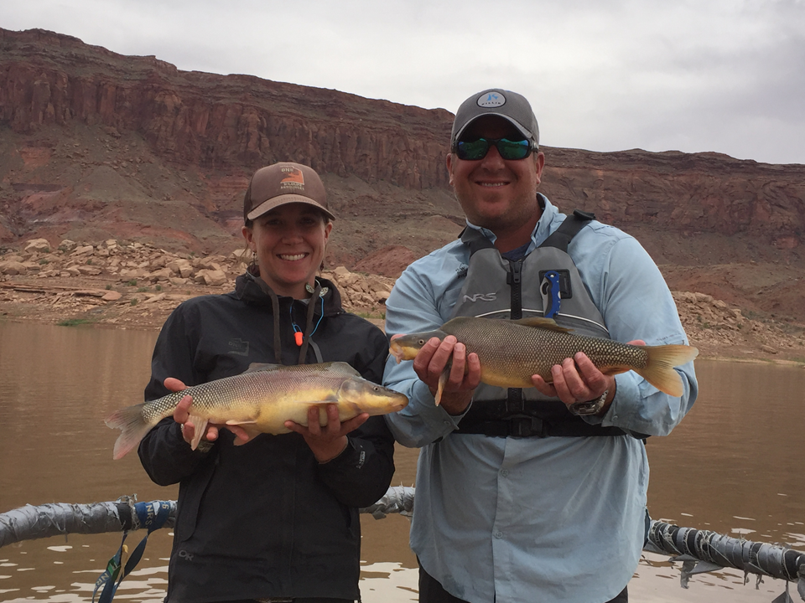
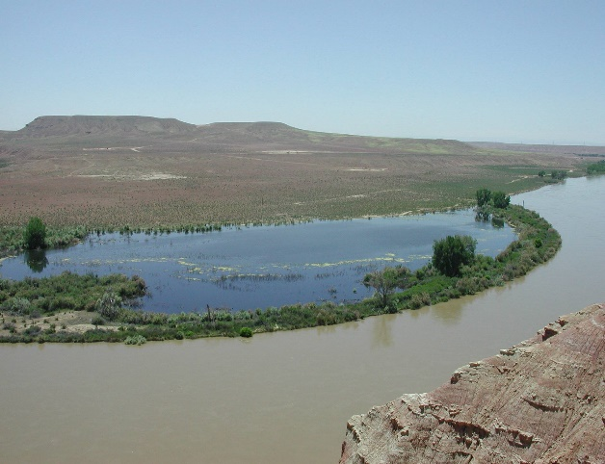
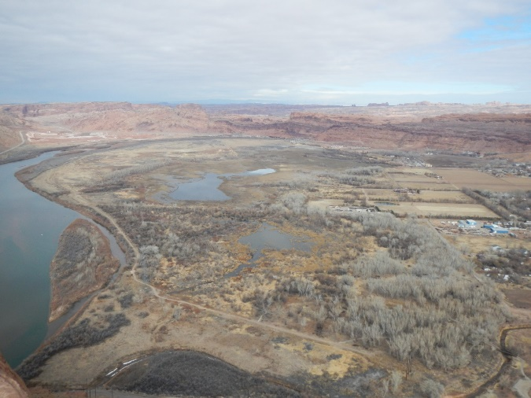
Flow and Floodplain Management

Slide 7
ESA (Section 4) Updates:
Progress and Projected Timelines
Species | SSA | 5-Yr Reviews | PDL + 4(d) rule | Final Rule | Revise Recovery Plan?
Humpback Chub | Complete; 3/2018 | Complete; 2011; 3/2018 | Publ. in Fed Reg. Jan 22, 2020; publ. comm period closed |  | Yes – after Final Rule clears region and draft RtoC submitted
Razorback Sucker | Complete; 9/2018 | Complete; 2012; 9/2018 | Signed by RD Walsh 9/30/2019 – sent to HQ | ?? Depends on scope and breadth of comments | Yes – to occur after Final Rule is complete
Colorado Pikeminnow | Complete 04/20 | May / June 2020 | N/A - Remains Endangered | N/A | Yes – start Summer 2020
Bonytail | no | Complete: 2012; 6/2019 | N/A - Remains Endangered | N/A | Not recommended at this time; reevaluate at next 5-Yr review

Slide 8
Colorado River Fish Listing Decisions: a Review
Colorado pikeminnow
Razorback sucker
Bonytail
Humpback chub
Endangered
Threatened
Recovered
A species [currently] in danger of extinction throughout all or a significant portion of its range
A species likely to become endangered in the foreseeable future throughout all or a significant portion of its range
A species not likely to become endangered in the foreseeable future throughout all or a significant portion of its range

Slide 9
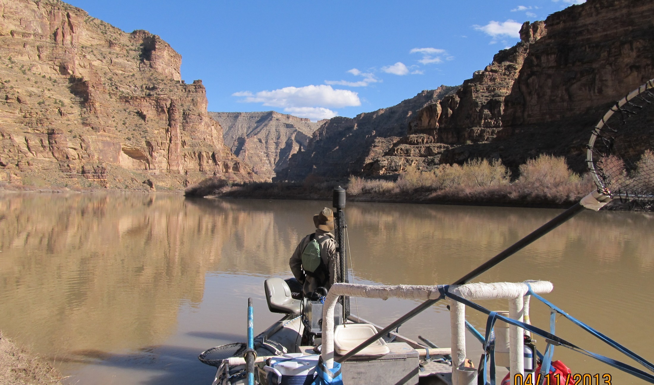
Future Status of the Programs
Programs’ Cooperative Agreements signed through 2023
PL 116-9 - Authorization for FY20 – FY23
Bills require a Report to Congress in FY21
Accomplishments
Status of the fish
Expenditures
Post 2023 Activities & costs

