Slide 1
Colorado River Basin Salinity Control Program Update Don Barnett Colorado River Basin Salinity Control Forum
Upper Colorado River Commission
May 19, 2020
Via Zoom

Slide 2
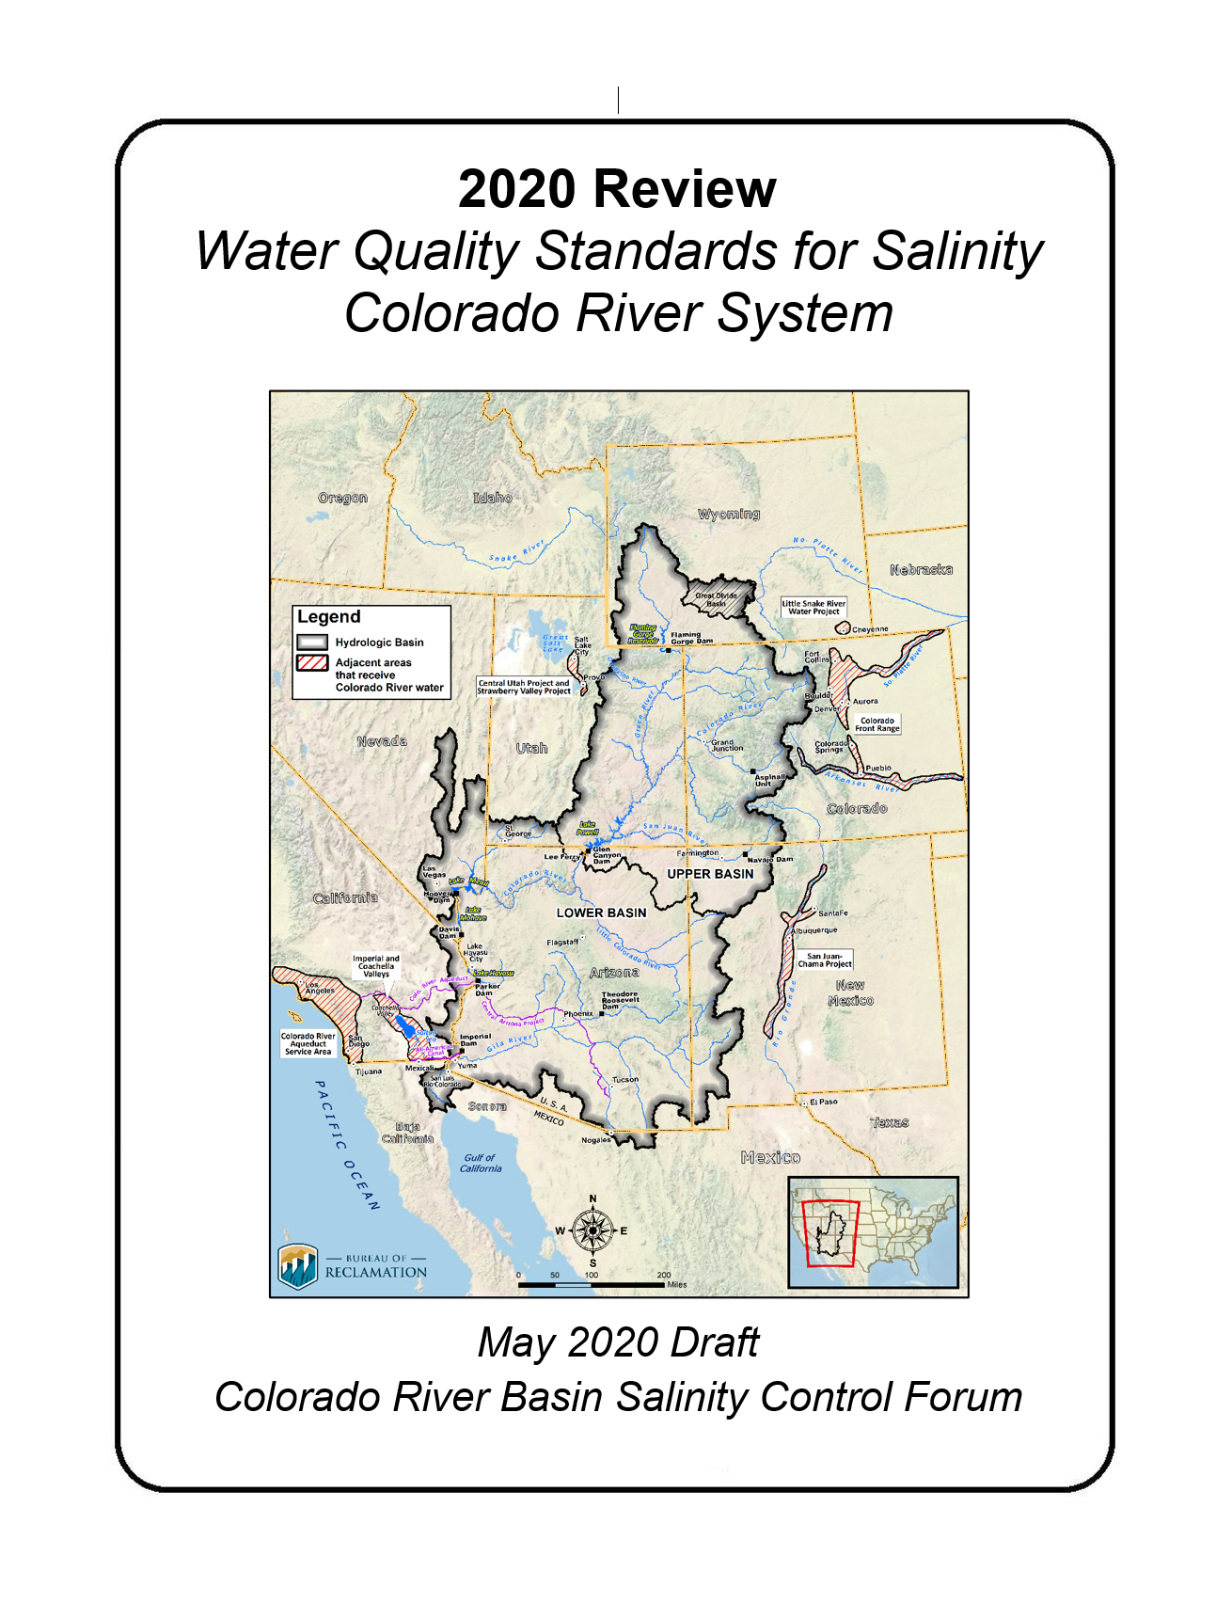
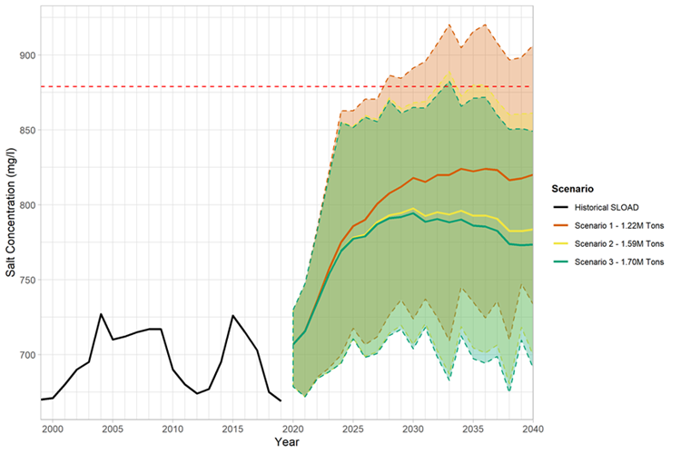
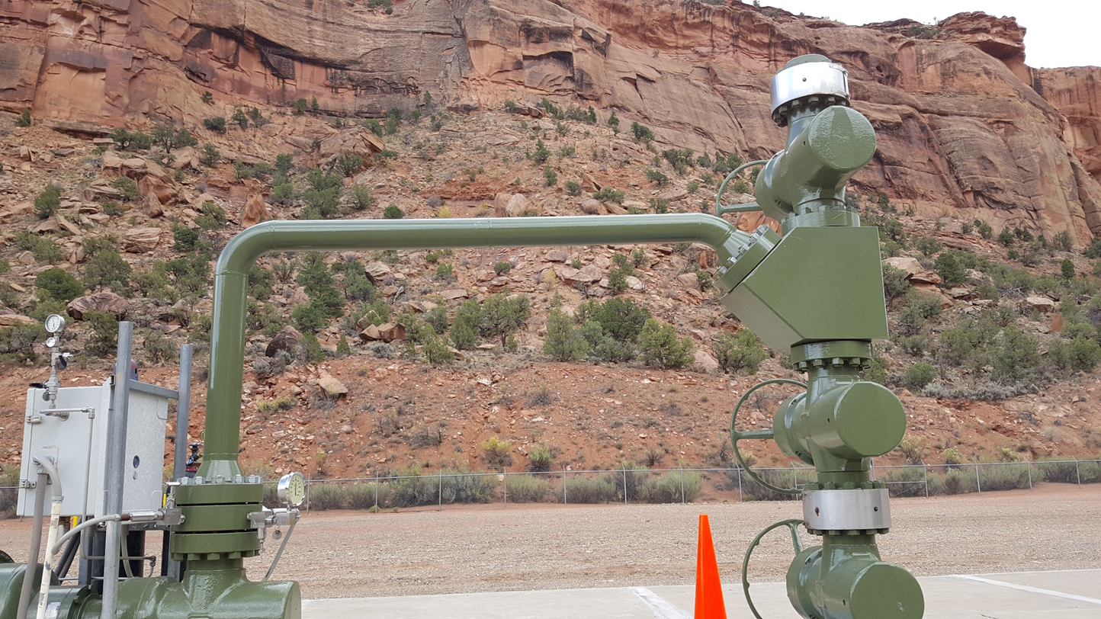
Salinity Program Update
Program Funding (2020)
Reclamation - $10M (Full, -$4M 2021)
BLM - $2M – (Full)
NRCS - $12.7M FA (Full)
2020 Review of
Water Quality Standards
Paradox Valley Unit (PVU)
EIS Efforts/Schedule
Resumption of Brine Injection

Slide 3
PVU EIS
June 8, 2020

Slide 4
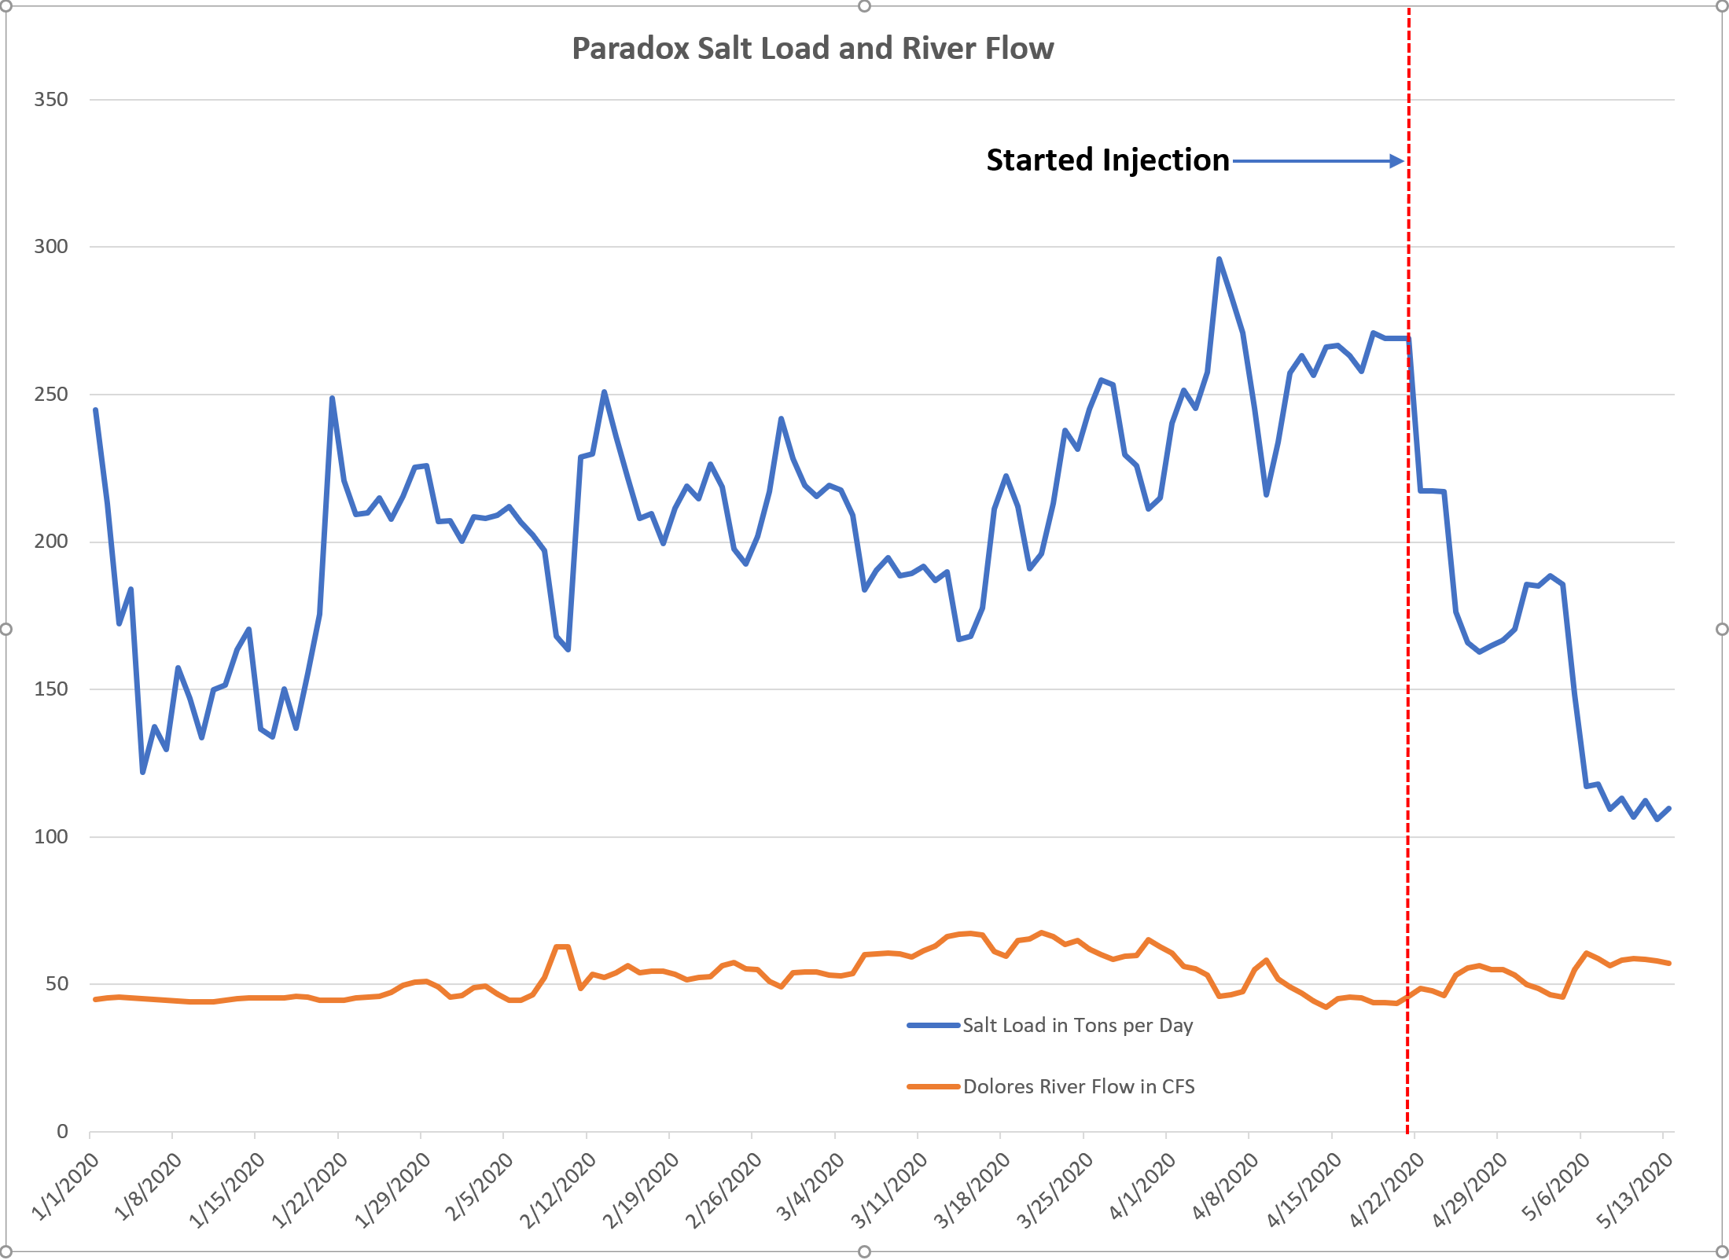
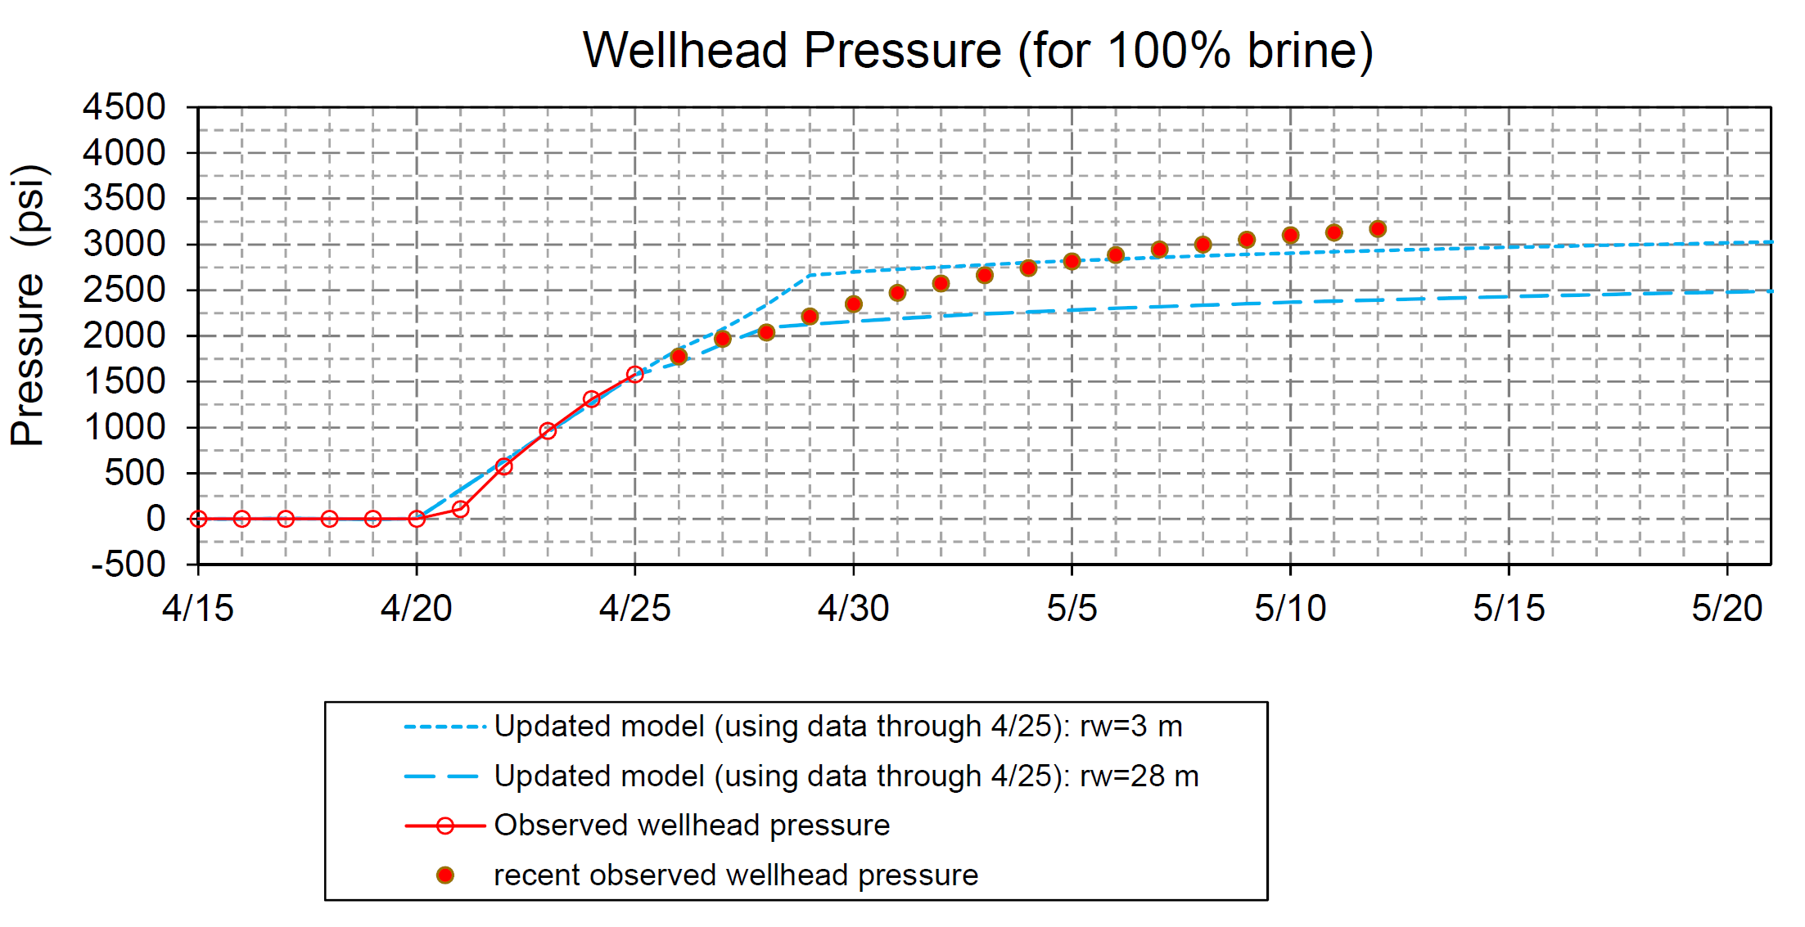
PVU – Resumption of Operations (Six-Month Injection Test)
seismicity

Slide 5
Colorado River Basin Salinity Control Program
Questions?

