Slide 1
UCRC Demand Management Investigations Grant and RFP
Recommendations from the evaluation committee to the UCRC
UCRC Regular meeting Online Webinar may 19th, 2020

Slide 2
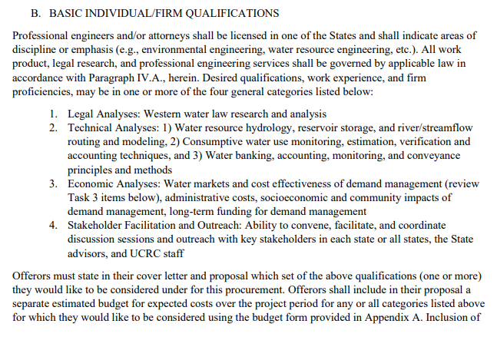
RFP Proficiency Categories
Proficiency Categories
Legal Analyses
Technical Analyses
Economic Analyses
Stakeholder Facilitation and Outreach

Slide 3
Scoring of Proposals Pass/Fail elements RFP Evaluation Criteria Proposal References Responses to Evaluation Committee Questions
Proposals Received

Slide 4
Evaluation Committee Recommendations
Legal Analyses | Smith Hartvigsen
Technical – Project Management | Hazen & Sawyer
Technical – Consumptive Use Estimation, Accounting, and Verification | Desert Research Institute (DRI)
Technical – Water Banking, Demand Management Storage and Shepherded Volumes Modeling and Routing | Precision Water Resources Engineering (PWRE)
Economic Analyses | AMP Insights
Stakeholder Facilitation & Outreach | J.U.B. Engineers

Slide 5
What’s Next…
If our Commissioners approve the recommendation and make the award
Proceed with contracts through June-July.
The Demand Management Committee will review and help develop contracts and prioritize tasks in the SOW.
All tasks/assignments made by the DMC and communicated to the (Offerors turned) Contractors through the UCRC
Proceed with the work tasks and receive periodic status updates from the PM or others
Grant period ends Sept. 2022

