Slide 1
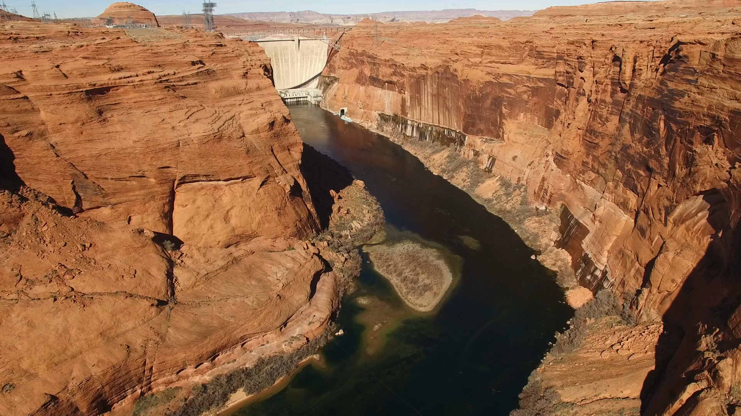
Executive Director’s Report
287th Regular Meeting of the
Upper Colorado River Commission
May 19, 2020
Amy I. Haas

Slide 2
Summary of Water Year 2019
UCRC Staff Activities

Slide 3


TRACKING EXCESS RELEASES PASSING LEEs FERRY GAGE--
Difference Between Glen Canyon Dam and Gage Reading
(in acre-feet)
Water Year | Acre-Feet | Water Year | Acre-Feet
2005 | 156,000 | 2013 | 32,000*
2006 | 264,000 | 2014 | 104,000
2007 | 166,000 | 2015 | 135,000
2008 | 186,000 | 2016 | 118,000
2009 | 160,000 | 2017 | 151,000
2010 | 184,000 | 2018 | 157,100
2011 | 213,000 | 2019 | 240,100
2012 | 108,000 | Sum | 2,374,200

Slide 4
unregulated inflow into Lake Powell: percent of 30-Year average
(most recent 30-yr Avg.)
Unregulated Inflow to Lake Powell
(as a Percent of recent 30-Year Average)
2000 – 62% | 2007 – 68% | 2014 – 96%
2001 – 59% | 2008 – 102% | 2015 – 94%
2002 – 25% | 2009 – 88% | 2016 – 89%
2003 – 51% | 2010 – 73% | 2017 – 110%
2004 – 49% | 2011 – 139% | 2018 – 43%
2005 – 105% | 2012 – 45% | 2019 – 120%
2006 – 73% | 2013 – 47%

Slide 5
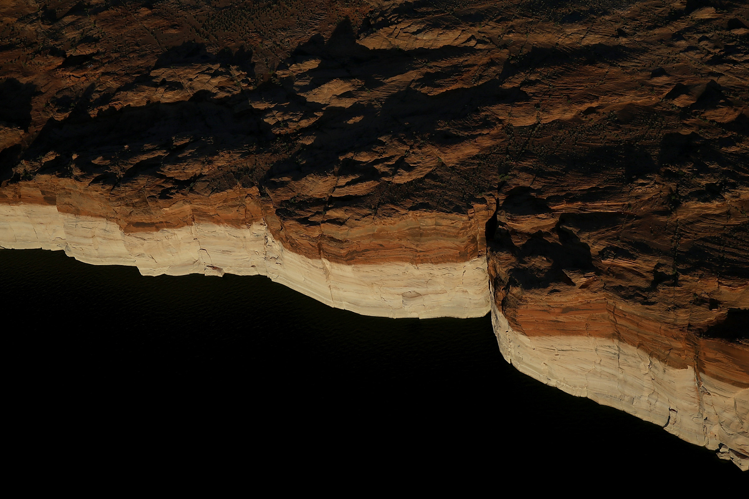
Storage in principal reservoirs – END of Water year 2019
Upper basin
  19.29 maf storage
  62% of live storage capacity
  3.25 maf gain in storage from WY2018
Lower basin
  12.43 maf storage
  44% of live storage capacity
  405 kaf gain in storage from wy2018

Slide 6

Colorado river flow at Lee ferry
WATER Year 2019
WY2019 estimated natural flow at Lee Ferry = 18MAF
Long-term average natural flow at Lee Ferry = 14.6 MAF (period of record: 1896-2019)
WY2019 historical flow volume at Lee Ferry = 9,264,105 AF
10 -year running total flow past Lee Ferry = 92,981,000 AF
10-year running total release = 17,981,000 AF more than Compact requires
10-year running total release = 10,681,000 AF more than minimum objective release
Notes:
1.

Slide 7
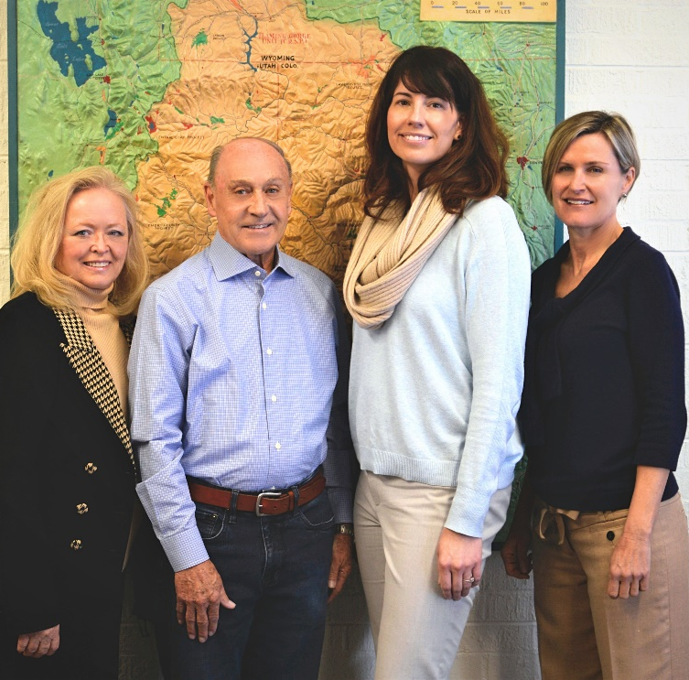
UCRC Staff

Slide 8
administrative activities—wy 2019 to present
Completion of WY 2019 Annual Report
UCRC Library-Digitization/Modernization efforts
IT IMPROVEMENTS—UCRC website
Continued savings under UCRC health plan
401k Plan best practices
Telework since late March due to Covid 19 pandemic
UCRC Building/potential move

Slide 9
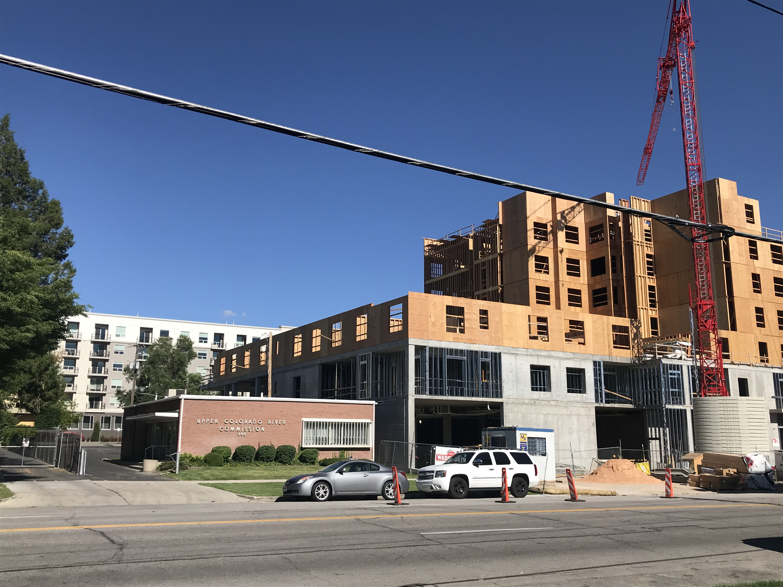

Slide 10
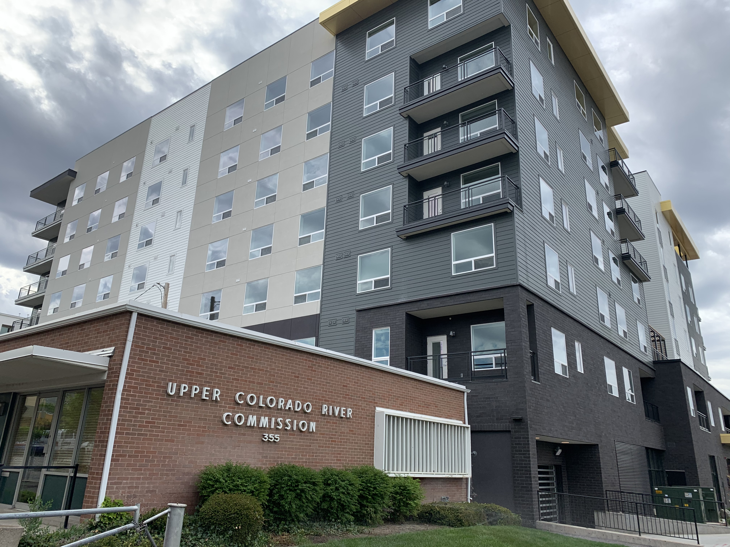

Slide 12
