Slide 1
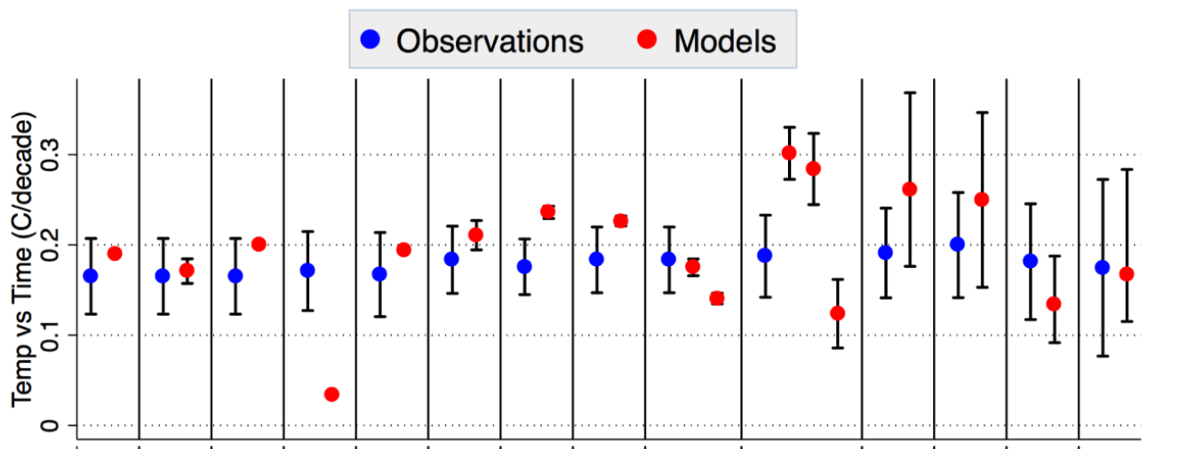
Water and Climate in the 21st Century:
Lessons from Recent CRB-Specific Scientific Studies
Upper Colorado River Commission
CRWUA
Las Vegas, NV
December 11, 2019
Climate Models to Observations since 1970
Brad Udall
Senior Scientist/Scholar
Colorado State University
Bradley.Udall@colostate.edu
Hausfather et al., 2019

Slide 2
Talk Outline
Climate Change in 2019
8 Key CRB Climate Change Studies since 2011
Lower Basin Flow Loss Evidence
Doing more than just adapting
Conclusions

Slide 3
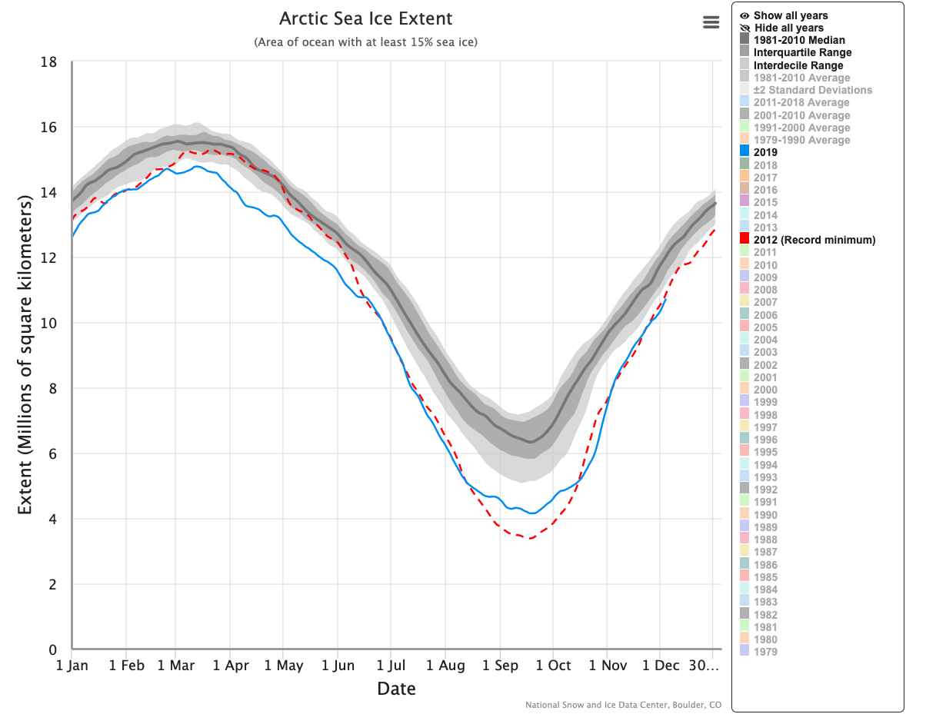
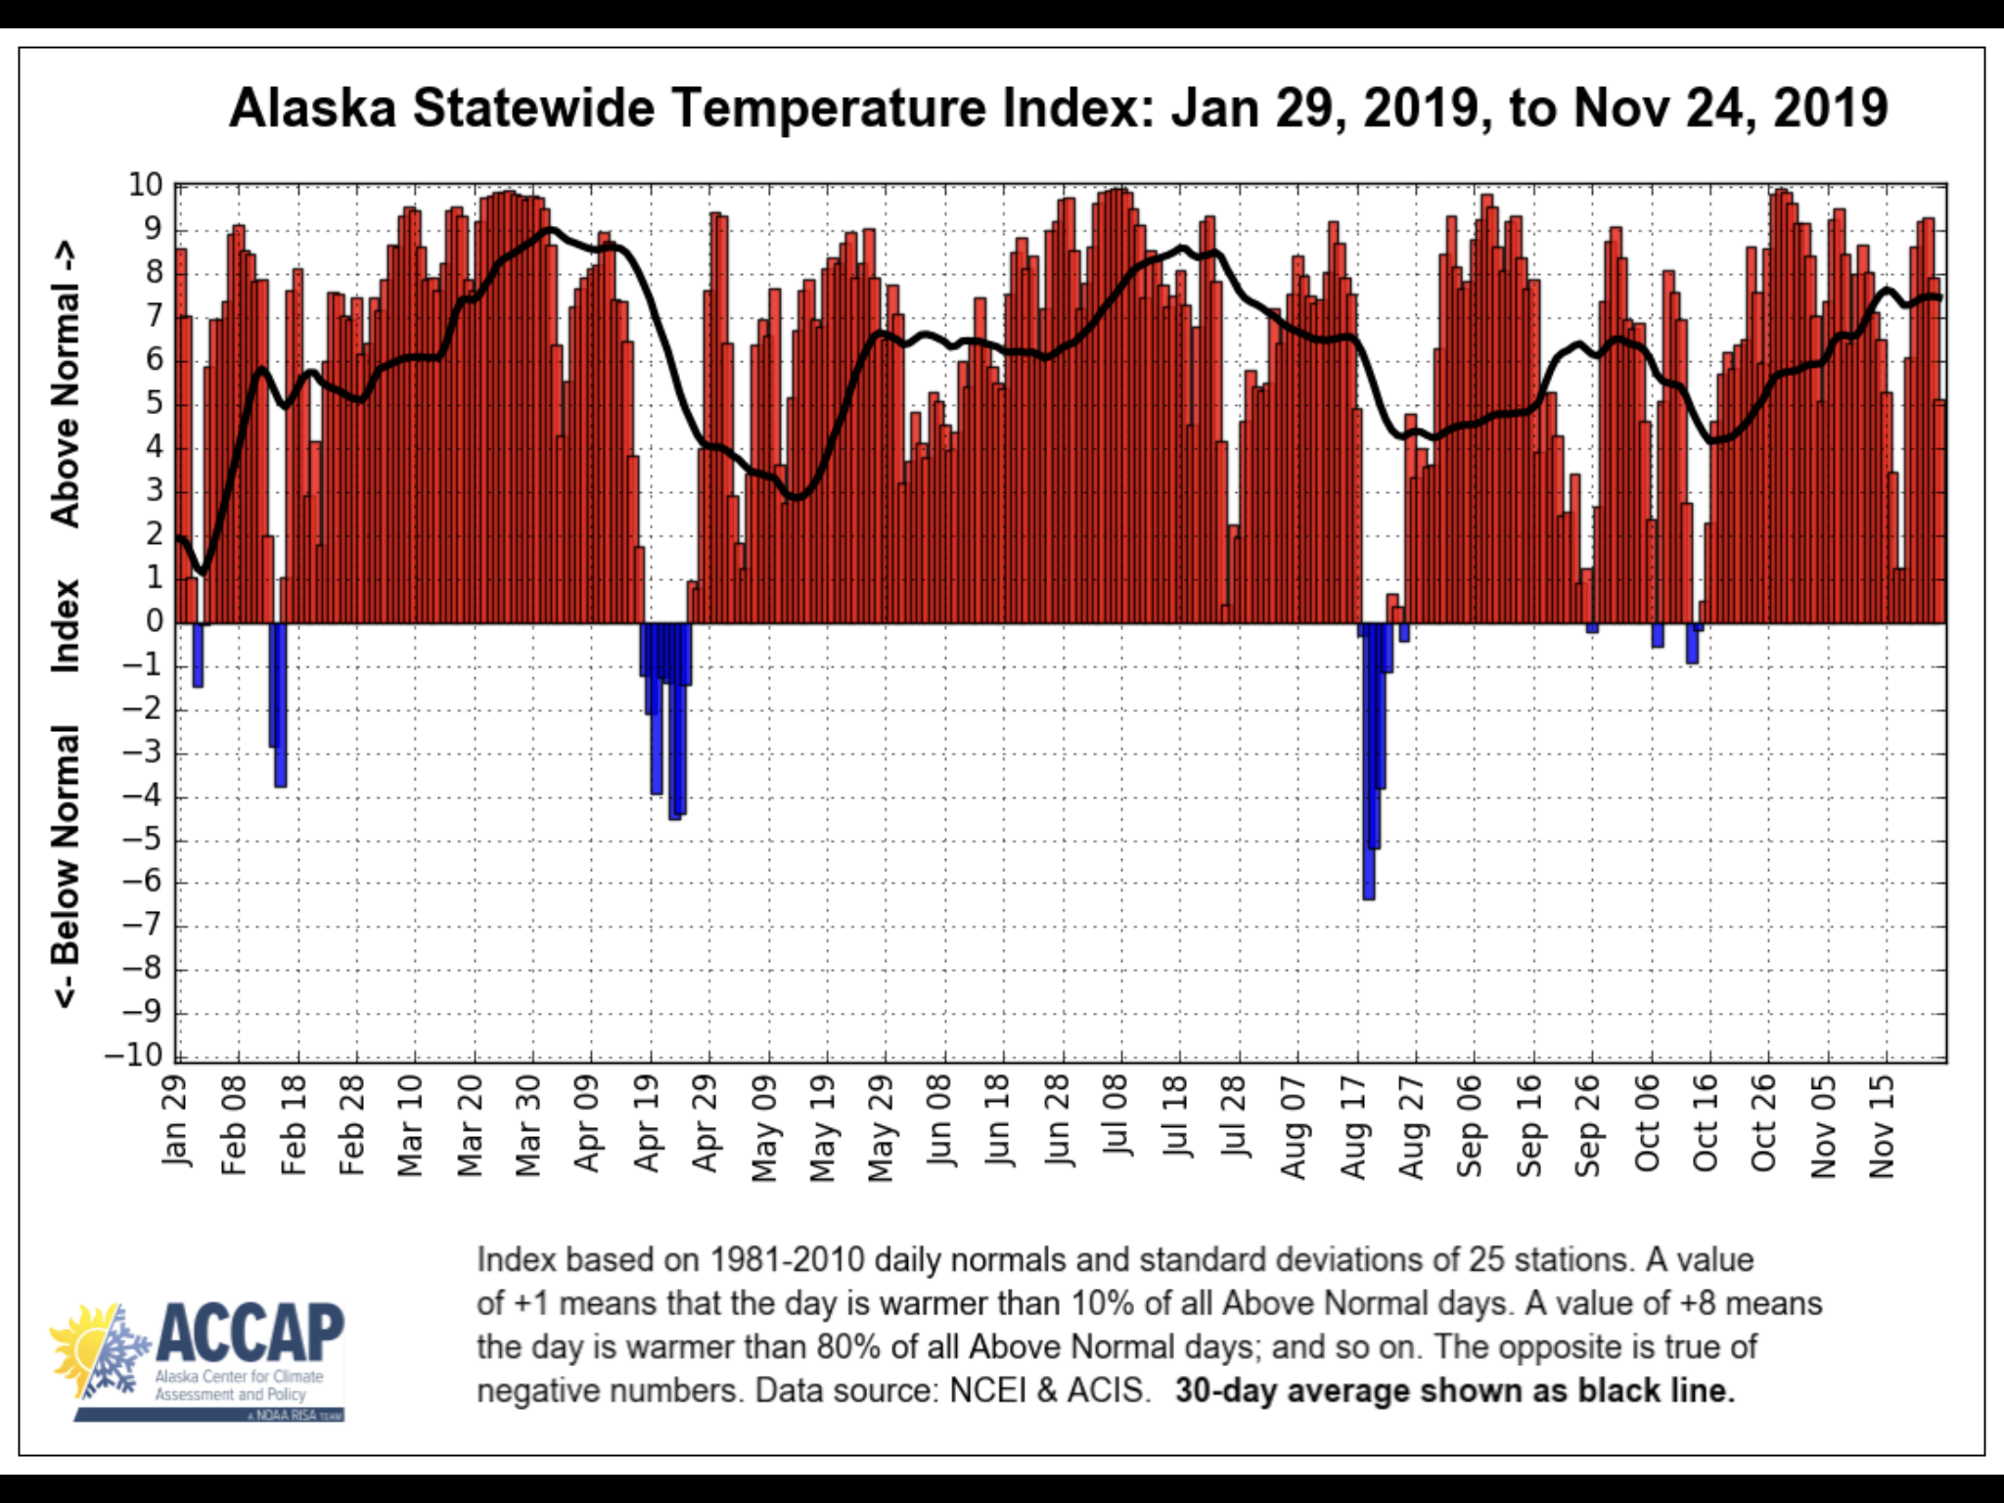
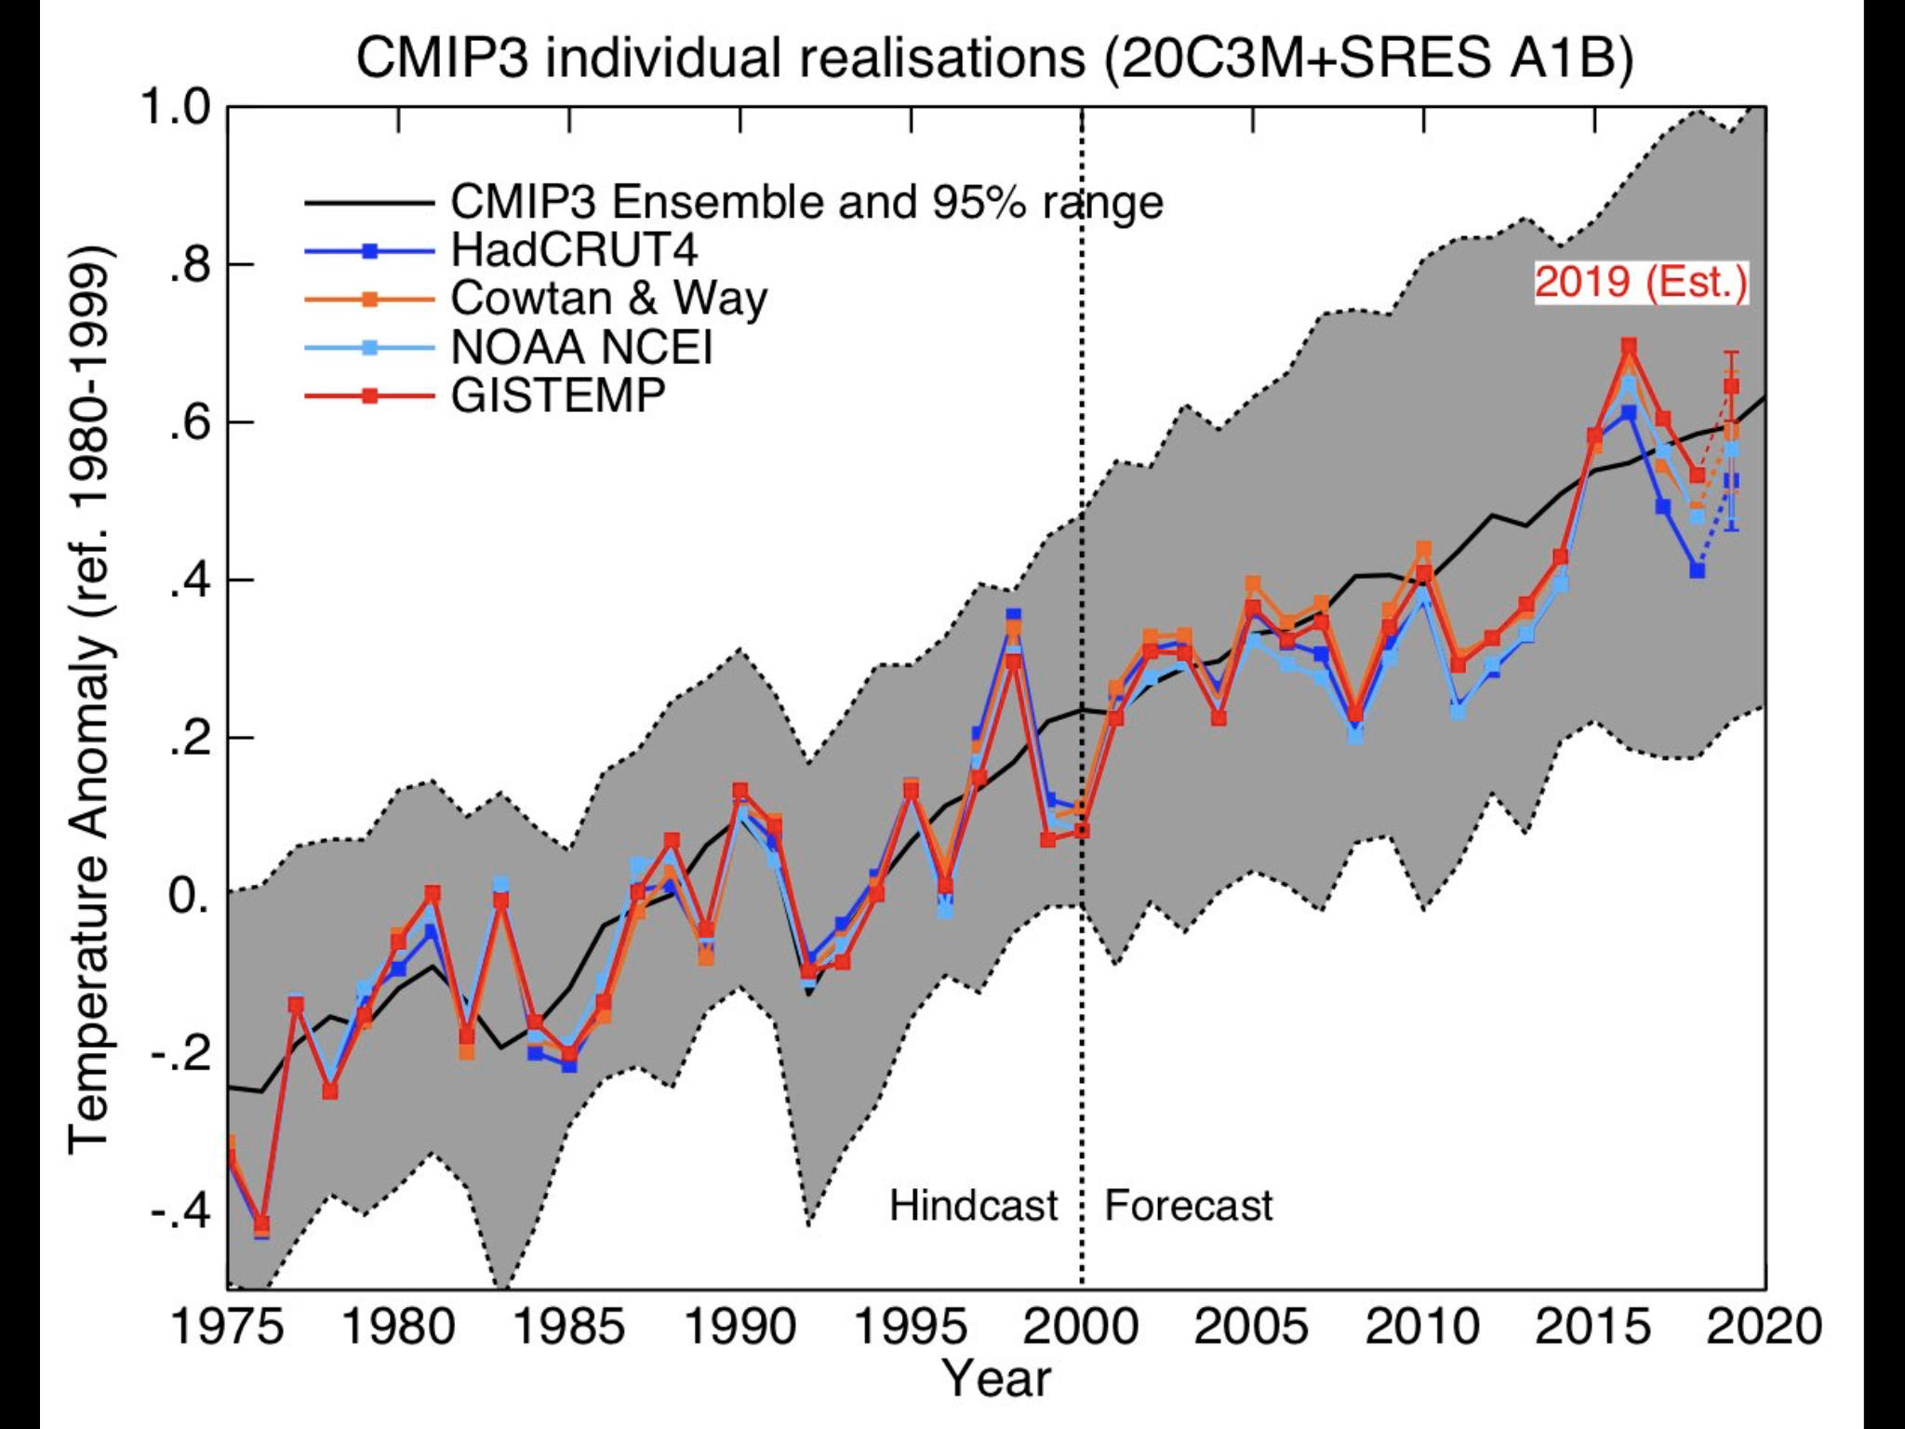
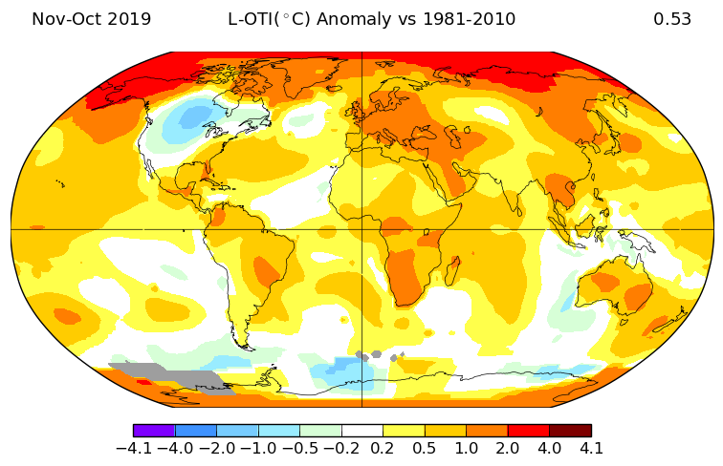
Notable 2019 Climate Change Events
2019 2nd Warmest in Recorded History
Alaska Record Temperatures way above normal
US only place cool globally
Midwest Floods
2 European Heat Waves: Nimes 114 °F
John Martin Reservoir in Colorado 112 °F
Huge Melt event on Greenland Ice sheet
Imelda 40 Inches Rain in Houston
Arctic Sea Ice Record Lows
Venice Flooding
California Fires (yet again)
CRB Flash Drought Late WY 2019
Changing Politics Nationally and Internationally

Slide 4
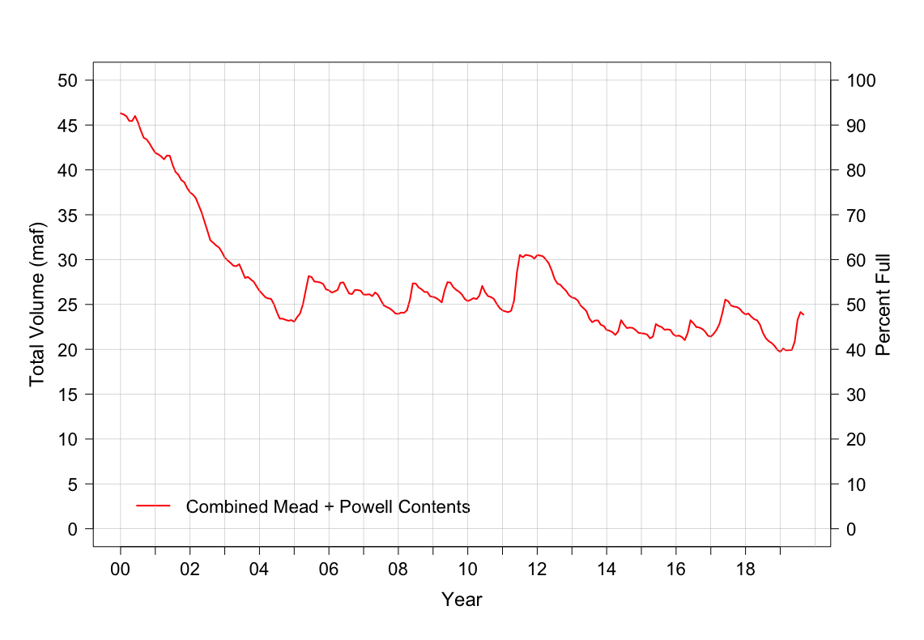
Current Colorado River Reservoir, Flow, Precipitation and Temperatures in Long-Term Context
Powell + Mead Contents 2000 to 2019
Thru August 1, 2019
Source: Adapted from Udall & Overpeck, 2017
Data thru September 2019

Slide 5
8 Key CRB Climate Change Studies Last 8 Years
Understanding Uncertainties in Colorado River Streamflows
  Vano et al., 2014
The Importance of Warm Season Warming to Western US streamflow changes
  Das et al., 2011
Increasing Influence of Air Temperature on Upper Colorado River Streamflow
  Woodhouse, 2016
The Colorado River Hot Drought and Implications for the Future
  Udall & Overpeck, 2017
On the Causes of Declining Colorado River Flows
  Xiao, Udall and Lettenmaier, 2018
Climate-Driven Disturbances in the San Juan River sub-basin of the Colorado River
  Bennett et al., 2018
Causes for the Century-Long Decline in Colorado River Flow
  Hoerling et al., 2019
Chris Milly new study on Temperature Sensitivity
  Under Review, 2020
  Note: many others, but I have elected to focus on these 8 that deal specifically with temperature increases and flow reductions / implications

Slide 6
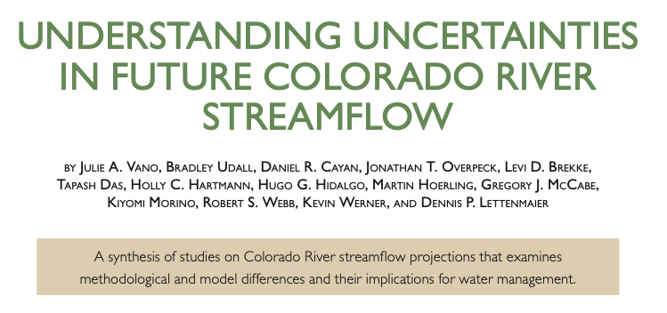
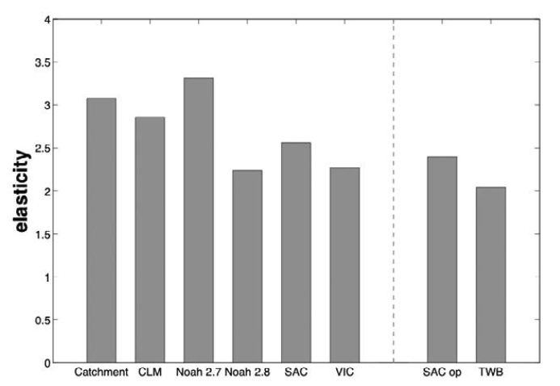
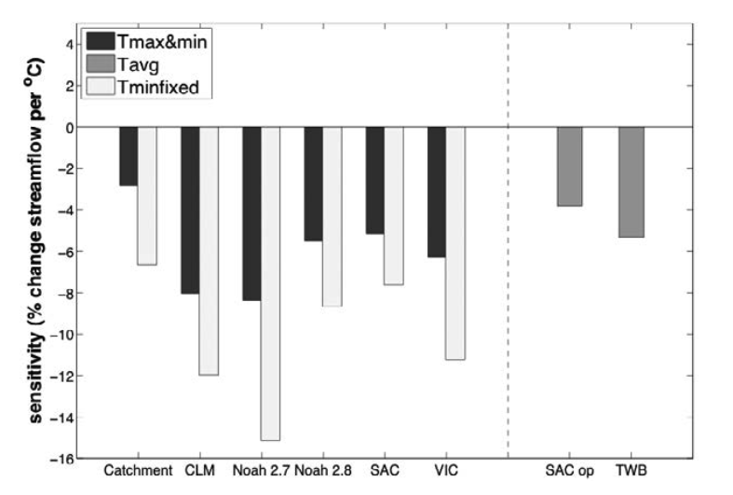
Introduced 2 key concepts (among many other things)
Precipitation Elasticity
  Ratio of the change in runoff to a 1% change in precipitation
  Approximately 2 to 3 (unitless number)
  2 means 1% change in precip means 2% change in runoff
Temperature Sensitivity
  Reduction in flow (as %) to 1°C temperature rise
  Approximately -3 % to -10 % / °C
  Always negative (implies flow loss)
  With 1°C rise, -5%/C sensitivity means 5% flow loss

Slide 7
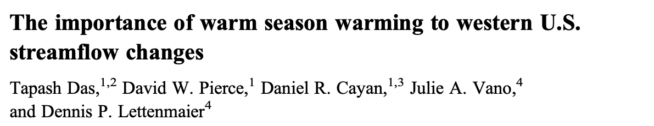
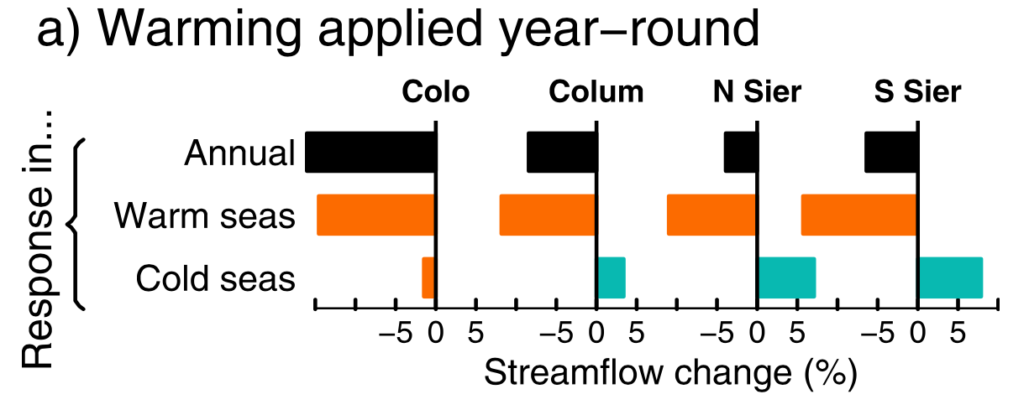
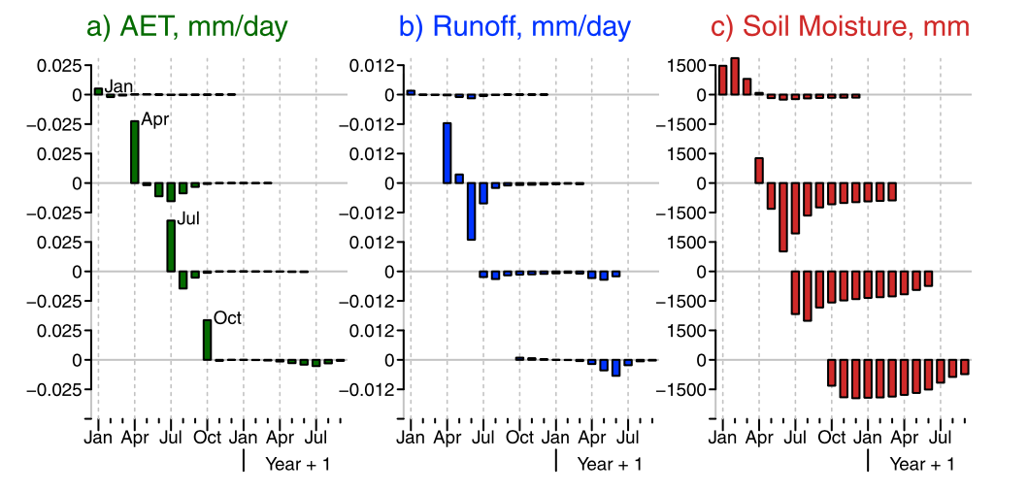
Hydrology Model Study over 4 Big Western River Basins
  Warming applied by single month/season
CRB most sensitive to annual warming: -16% flow loss with 3C warming (implies ~5%/°C loss)
Summer Warming most important.
  Affects flow that summer and following summer via soil moisture deficits.

Slide 8
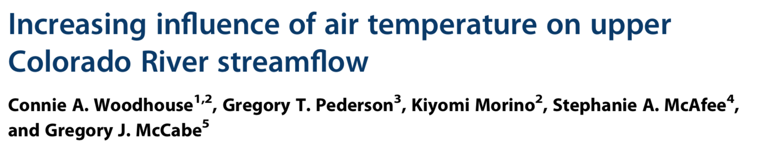
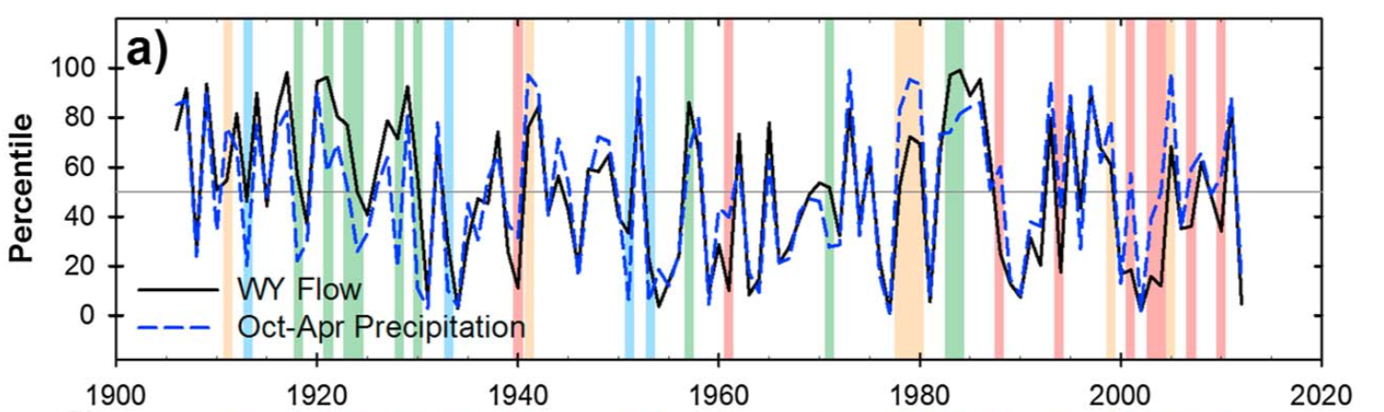
- 2016
Temperature can be a major flow driver (normally we just think about precipitation)
Since 1988 flows have been less than expected given winter precipitation
Warm temperatures exacerbated modest precipitation deficits in the Millennium Drought

Slide 9
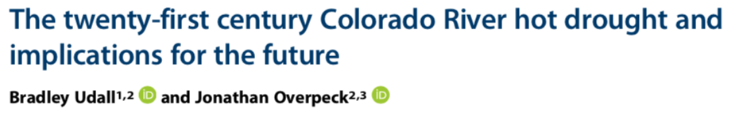
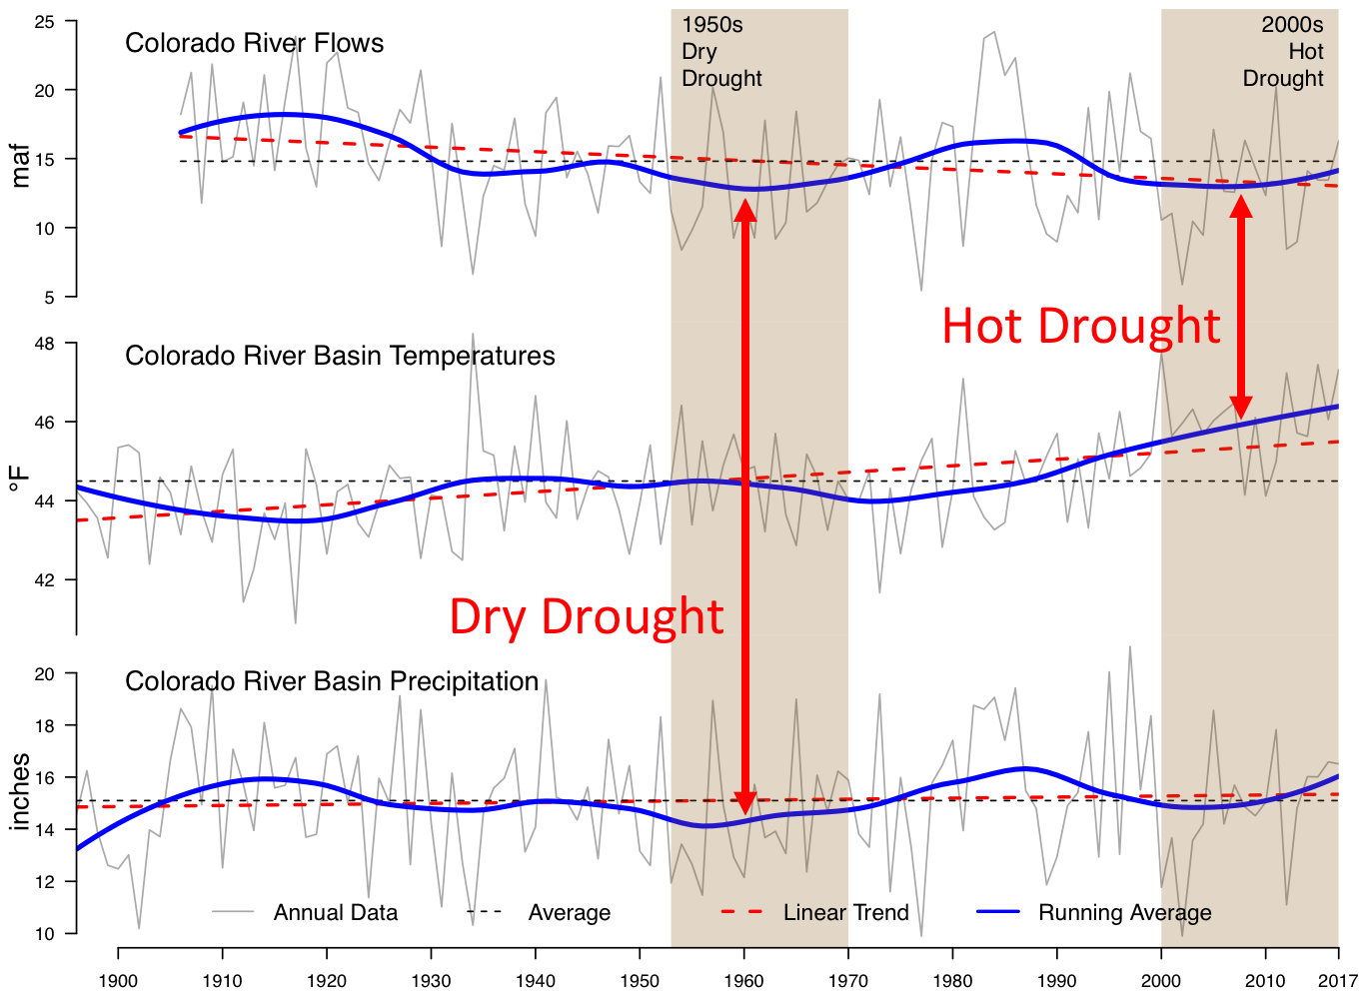
- 2017
Precipitation declines only partially explain flow loss
  ~ 66% of the loss
Temperature increases explain the remainder
  ~ 33% of the loss
Why?
  More Evaporation
  Thirstier Atmosphere
Temperature-Induced Losses
  Now = ~6%
  2050 = ~20%
  2100 = ~35%
Udall and Overpeck, WRR, 2017

Slide 10
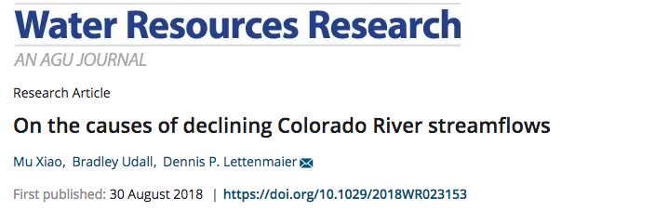
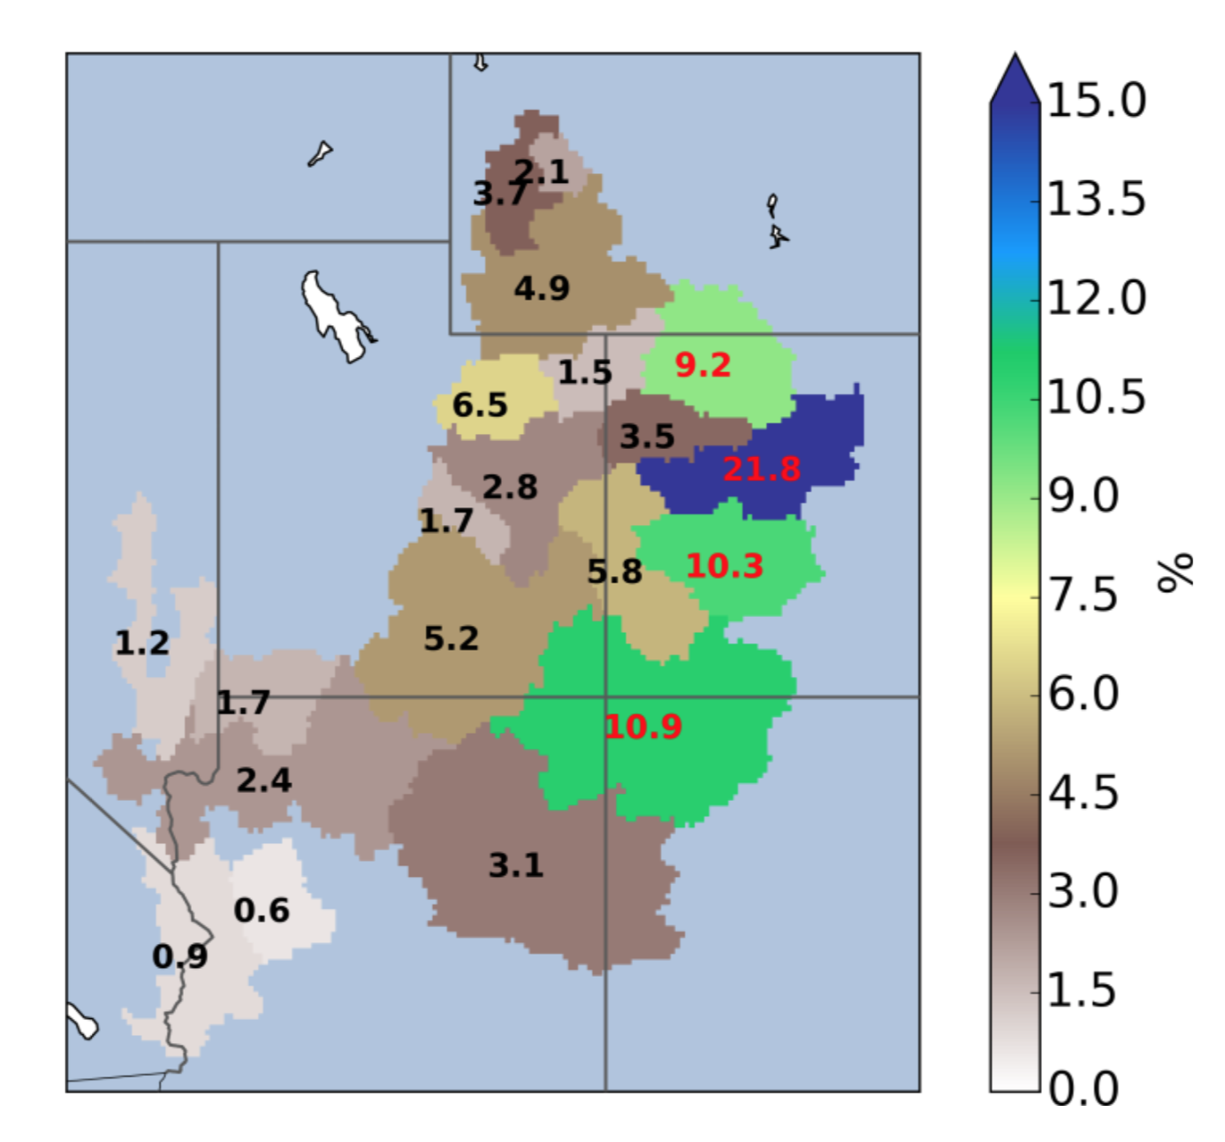
Hydrology Model-based Study using Historical Data
  Run model with and without temperature change
Findings
  ~50% of Decline due to Higher Temperatures
  More Evaporation of all kinds
  ~50% of Decline due to Changing Precipitation Patterns
  Shift to less productive basins
4 Key Basins (Green + Blue) produce ~55% of all runoff

Slide 11
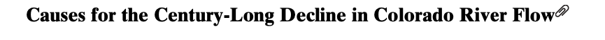
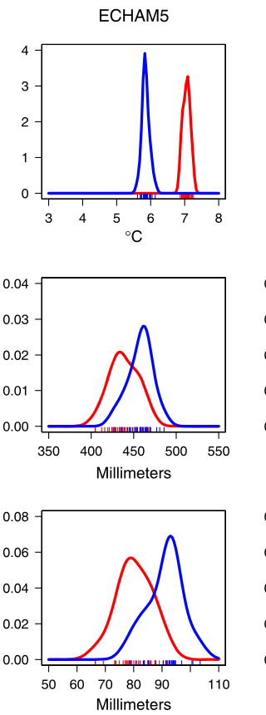
Climate Model Results 1981-2010
Temperature
Hoerling, Barsugli, Livneh, Eischeid, Quan, Badger, 2019
Without Climate Change
With Climate Change
Sophisticated Multi-model Multi-Ensemble GCM Effort with and without added greenhouse gasses
20% Flow Decline over last century
50% of that due to climate change (i.e. 10% flow loss)
Climate models show 1.2°C warming and 3% precip decline
Precipitation Elasticity of ~ 2
Temperature Sensitivity of ~ -2.8% to -7% /°C
Warming is 1/3 of the decline (~3 % of flow)
Precipitation Loss is 2/3 of decline (~7 % of flow)
What’s New:
1. Attribution of 1981- 2010 precipitation decline to climate change
2. Lower Temperature Sensitivity
Precipitation
Runoff

Slide 12
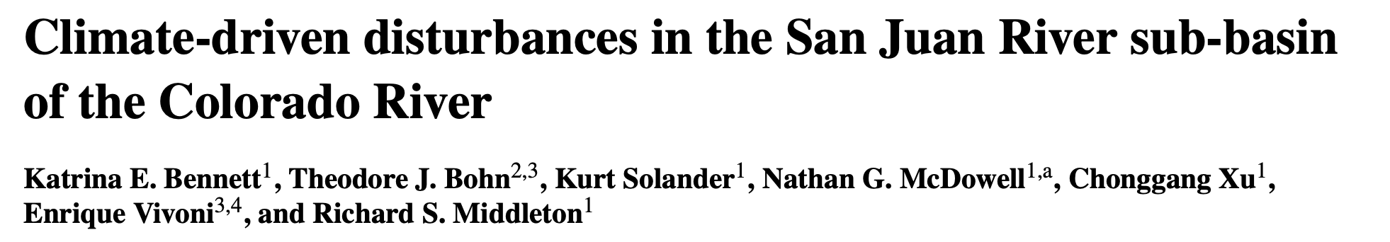
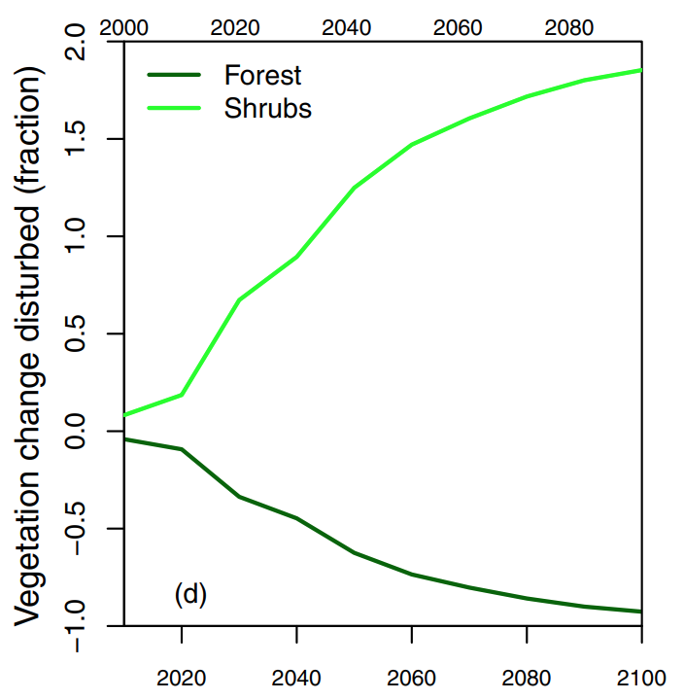
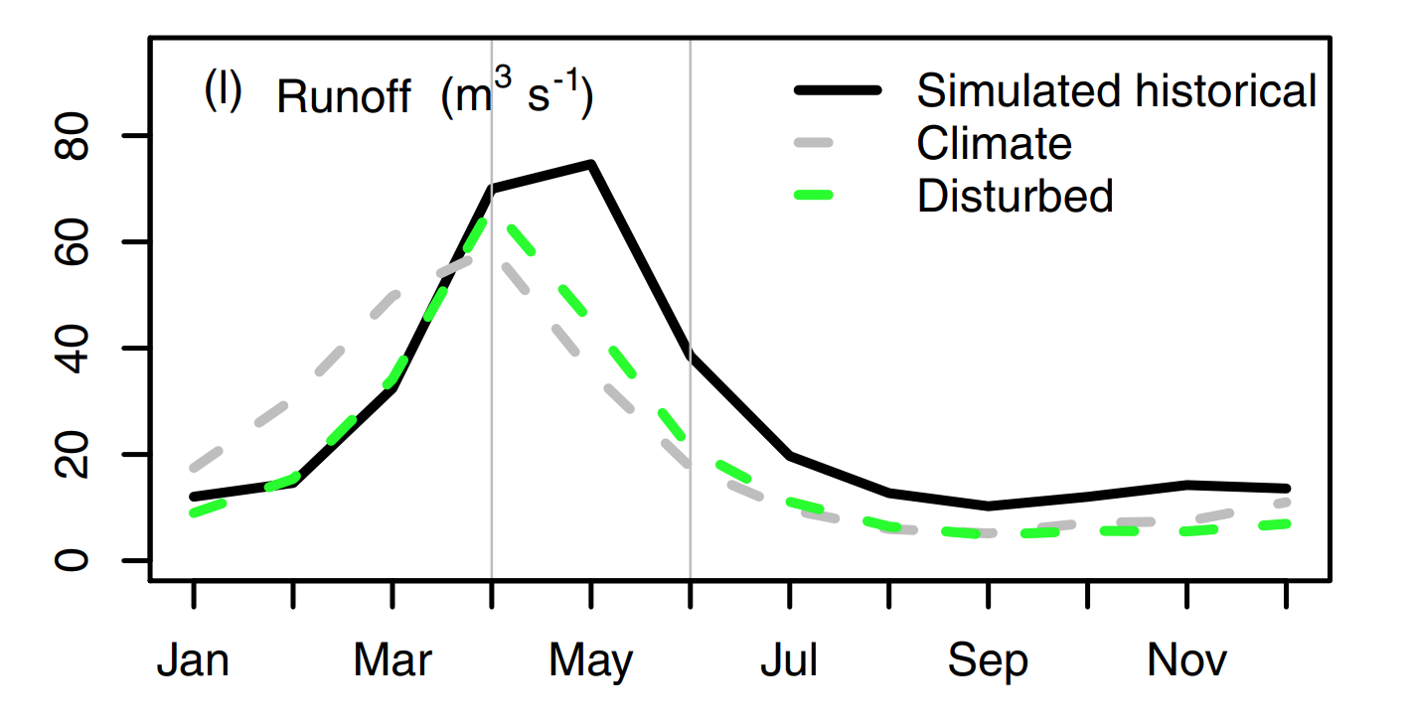
January, 2018
Wildfire, Drought, Pests expected to change forests significantly – lots of shrubs to replace trees
Few studies quantify both climate change and land cover disturbance
‘Robustly calibrated’ VIC Model
End-century streamflow is at least 6-11% lower than climate change only

Slide 13
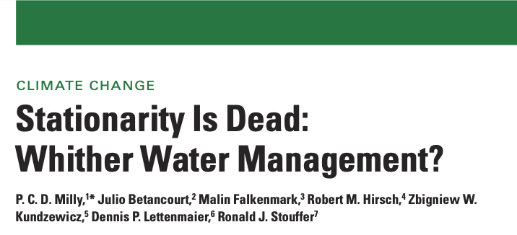
Chris Milly’s (USGS – NOAA GFDL Lab) new study
Lead Author of ‘Stationarity is Dead’
Effort is ‘In Review’ at an important journal
Attempt to ‘reconcile’ the wide range of CR Temperature Sensitivities
Answer: -9.3 %/°C !
Mid-century flow loss (only T)
  -14% to -26% RCP4.5
  -19% to -31% RCP8.5
Mid-century flow loss (both T&P)
  +5% to -24%
  +3% to -40%
Key Finding: As shiny, reflective snow declines, absorbed radiation goes up (2/3 of the cause)

Slide 14
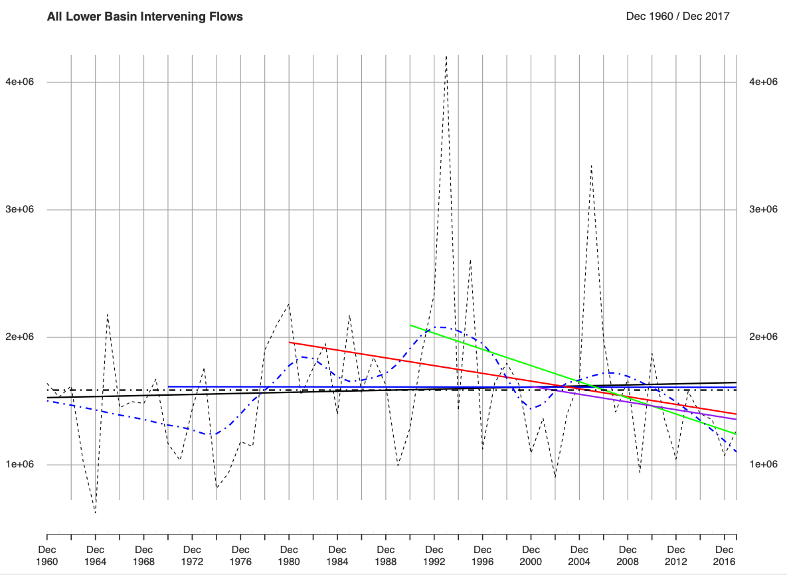
Emerging Evidence of Lower Basin Inflow Loss
Lower Basin Inflows (Rivers + Gains/Losses)
Unpublished Work
Lower Basin inflows from 1980 show strong downward trends
Total Loss ~ 250,000 af/year
(~ 16% of total inflow)
Makes Structural Deficit Worse
Loss is from the LB Rivers, not channel losses (Paria, LCR, Virgin, Bill Williams)
4 maf
4 maf
3 maf
3 maf
2 maf
2 maf
1 maf
1 maf
Source: Reclamation Natural Flows
Analysis: Udall

Slide 15
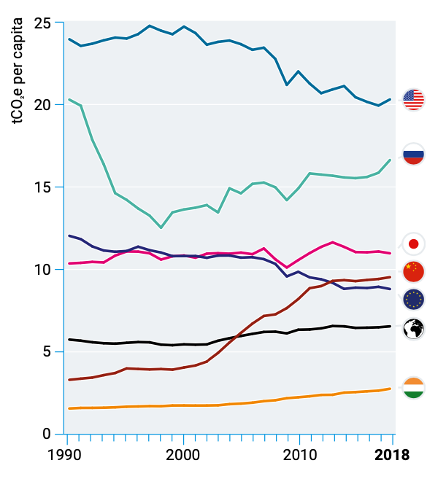
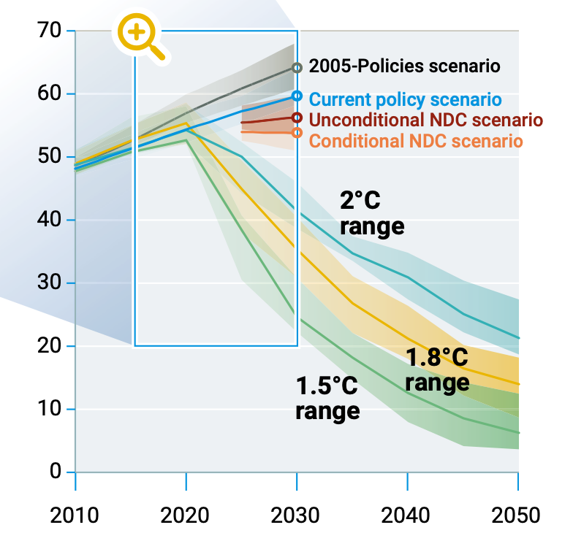
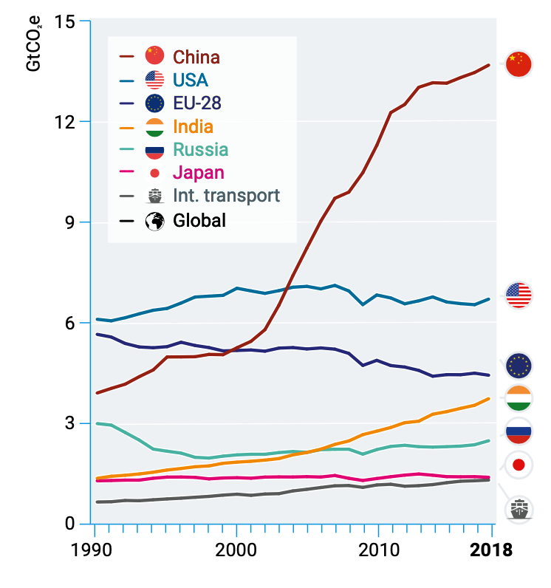
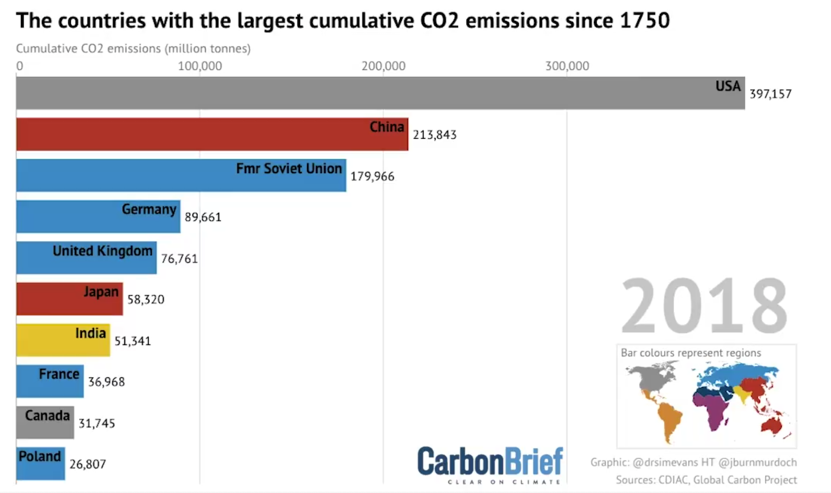
Adapting is not enough
CO2 Emissions by Country
US now 2nd largest emitter on annual basis
US largest cumulative emitter by far
US per capita emissions 2x China, Europe, 4x India
Emissions continue to rise but solution requires net zero emissions ASAP
Enormous Gap between 2°C Target and current path (~3.2 °C ) (CRB / Land Higher)
World Leadership Desperately Needed
Withdrawing from the only international agreement (Paris) is wrong
Inaction will be increasingly expensive
USA
Russia
Japan
China
EU-28
Global
India
UN Emissions Gap Report, 2019

Slide 16
We know how to solve this…
Price on Carbon
  Important but only a piece
Tax Credits
  Investments
  Production (e.g. wind)
Renewable Portfolio Standards
Research and Development $
Technologically possible solutions now appearing for difficult to de-carbonize sectors, e.g. aviation.

Slide 17
Conclusions
Concepts of Temperature Sensitivity and Precipitation Elasticity are useful
  Allow us to separate two important changes
Wide Variety of recent CRB studies point to declining flows
  Up to half of the current 20% decline is climate change
Two Cumulative Causes of Flow Declines
  Temperature (most studies)
  Precipitation (Hoerling et al, 2019)
Two studies explicitly quantifies future losses
  But Implicit in all studies
Temperature Impacts Carry Over from Year to Year
  Soil Moisture Memory Important
Some emerging evidence for Lower Basin Flow Loss
  First Place we’d expect to see losses
In the face of a planet changing event, adapting is not enough.
  We have to address the root cause of these changes
New Water
Old Water
Runoff is partly lagged, mimics
first-in – first-out buffer
A depleted buffer reduces runoff at a later time

Slide 19
Bradley.udall@colostate.edu
@bradudall

Slide 20
USA
Russia
Japan
China
EU-28
Global
India

Slide 21
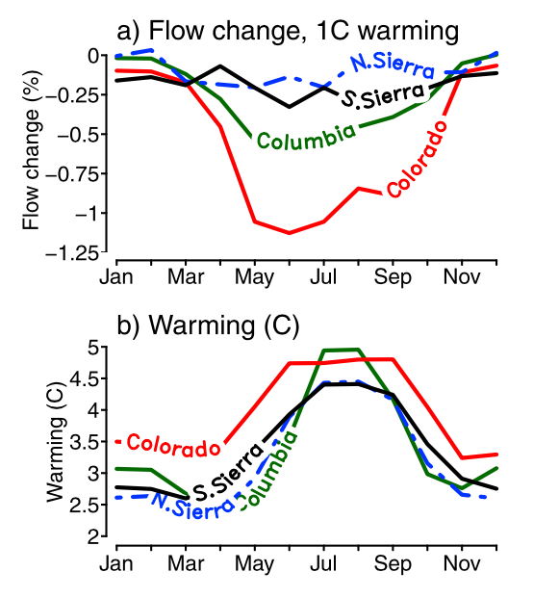
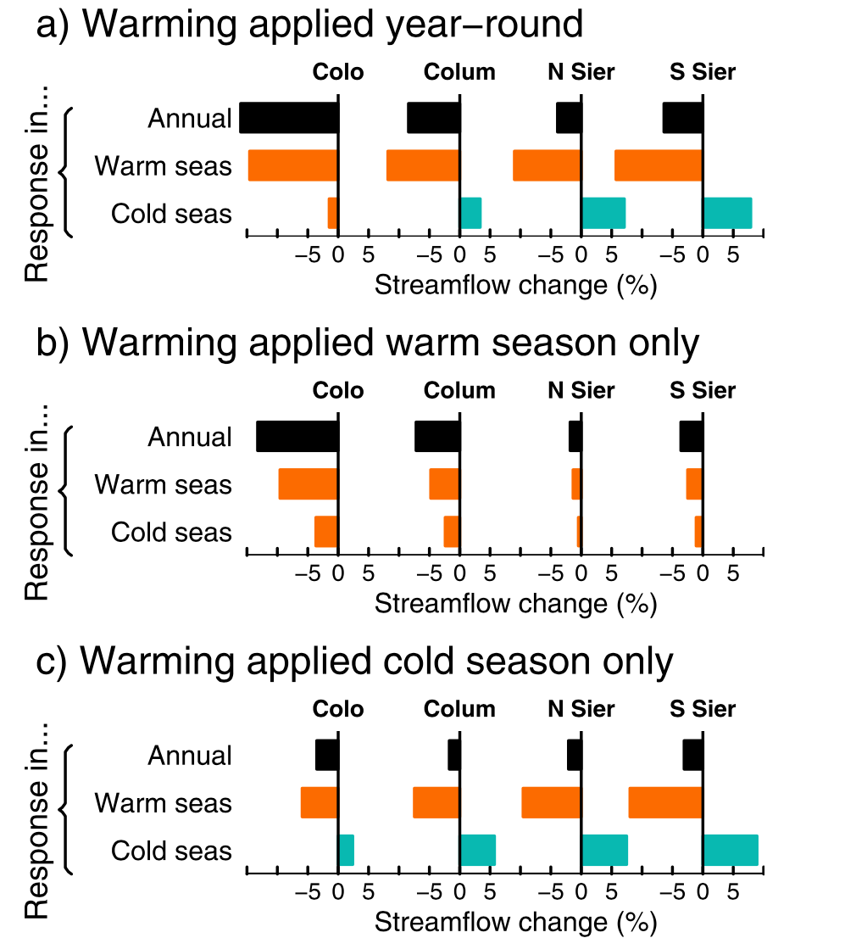

Slide 22
