Slide 1
National Park Service Update to the Upper Colorado River Commission
Colorado River Program
December 2019

Slide 2
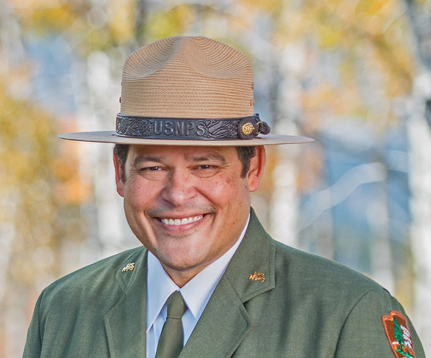
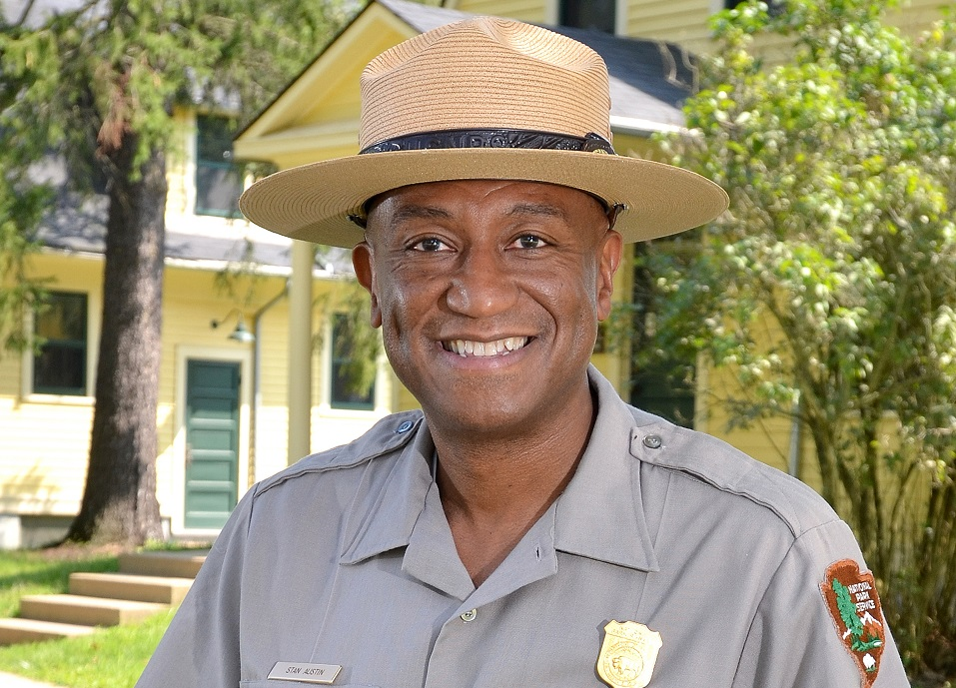
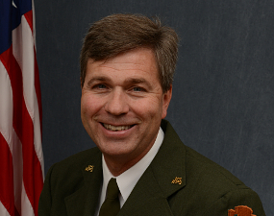
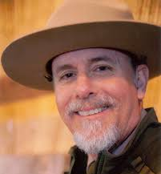
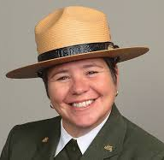
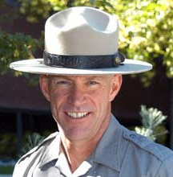
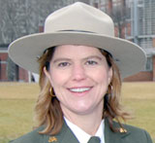
Leadership Changes
Colorado River Program
Acting Director of NPS – David Vela
Regional Director – Stan Austin (DOI 9,10)
Regional Director – new Mike Reynolds (DOI 6,7,8)
Colorado River Steering Committee
Dinosaur – new Paul Scolari
Lake Mead – new Margaret Goodro
Glen Canyon NRA – Billy Shott
Rocky Mountain NP – Darla Sidles
Curecanti/Black Canyon – Bruce Noble just retired, Deanna Greco acting
Arches/Canyonlands – Kate Cannon retiring
Grand Canyon – Mary Risser acting

Slide 3
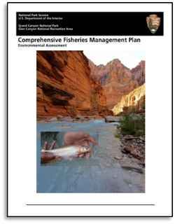
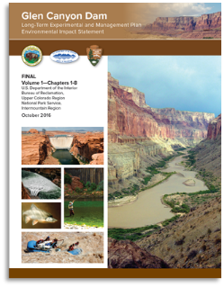
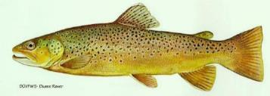
Expanded Non-Native FONSI
Colorado River Program
This EA identifies new tools that control non-native fish and other aquatic organisms, in addition to the LTEMP and CFMP tools, in order to protect native fish in Glen and Grand Canyon and recreational trout fishery in the Glen Canyon Reach
Public Draft published September 2018
FONSI signed October 2019
Currently in process for setting up funding, agreements and infrastructure for the Incentivized Harvest program in Glen Canyon Reach
2013 CFMP
Green sunfish found below dam 2015–2018
Smallmouth bass - very high threat
Brown Trout currently spawning in Lees Ferry Reach
2016 LTEMP
2019 Expanded Non-Native

Slide 4
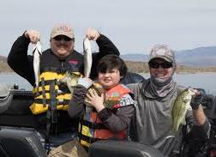
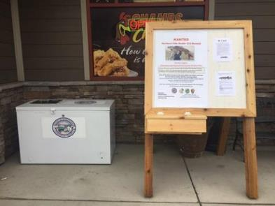
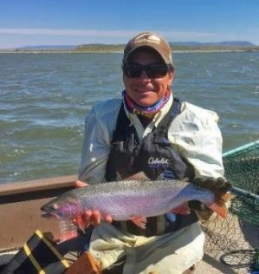
Proposed Action – Brown Trout in Glen Canyon NRA
Colorado River Program
Incentivized Harvest in Glen Canyon Reach
Three approaches:
Guided Fishing Trips for Tribal Youth and Members
Payment system to encourage restoration rewards (remove brown trout)
Tournament prizes focused on removing brown trout
NPS will pilot incentivized harvest for 3 years before using other tiers unless there is a major/rapid brown trout population increase
Expands fishing opportunities and encourages anglers to help manage
Allows selected Tribal Youth and Elders to visit Glen Canyon
Notes:
Explain how we have addressed concerns, why effective based on modeling, other NPS uses in other places

Slide 5
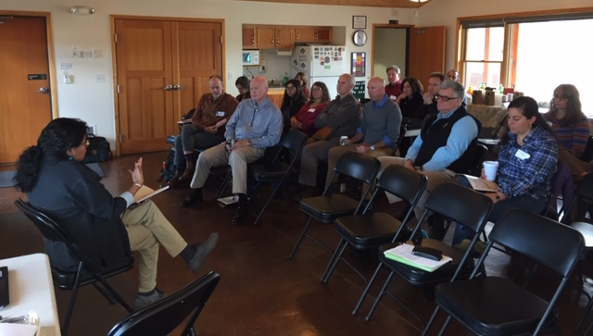
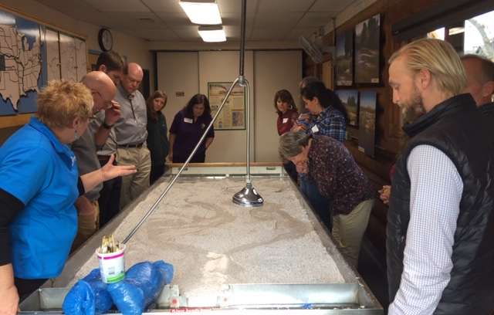
NPS Colorado River Program Cooperation with Partners
Colorado River Program
Ongoing coordination on Glen Canyon Dam AMWG/TWG
Ongoing coordination with Annual Operating Plan
Ongoing coordination with Flaming Gorge/Aspinall Ops
Upper Basin Recovery Program and San Juan Recovery Program
LTEMP and Expanded Non-Native EA
Little Colorado River dam proposal
Included Upper Basin States in our
Annual Colorado River Steering Committee Meeting
(Planning to include Lower Basin States next year)
Would like close coordination with UCRC as we move into:
Upper Basin Drought Contingency – Drought Response Operations Planning
Evaluation of the Interim Guidelines and planning for IG2.0
It is clear to us that meeting the future challenges on the Colorado River will require even more coordination than we have had in the past

Slide 6
Questions? Rob Billerbeck rob_p_Billerbeck@nps.gov 303-987-6789
Colorado River Program

