Slide 1
Upper Colorado Basin
Brent Esplin, Regional Director

Slide 2
Upper Colorado Basin Highlights
Welcome Wayne Pullan, Deputy Regional Director
Other key personnel changes

Slide 3
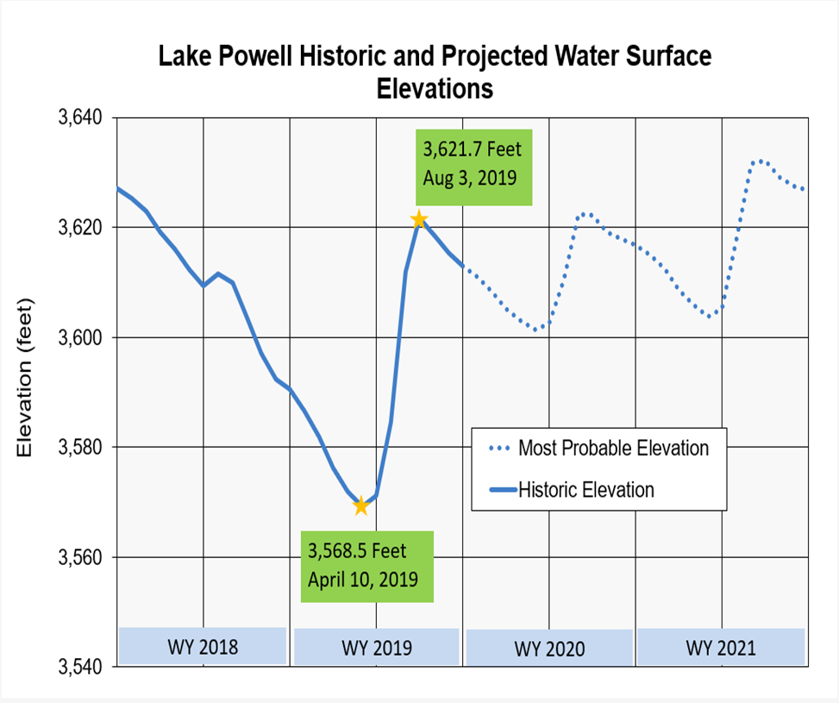
Upper Colorado Basin Hydrology
Above average runoff into Lake Powell in WY2019
Looking ahead to WY2020
Notes:
Water Year 2019 runoff was sufficient to restore system storage levels to conditions prior to WY2018, which was a particularly dry year for water
Inflow: 12.95 maf, 120% of avg
Releases: 9.0 maf to Grand Canyon
Ended the year at 55% capacity, 20’ higher than 2018
Total WY2019 unregulated inflow to Lake Powell was 12.95 maf, 120 percent of average.
- Difference between the 145% of average spring runoff and total water year inflows caused by dry conditions in Fall 2018 and record dry conditions in Summer 2019.
Lake Powell released 9.0 maf in WY2019
Powell ended WY2019:
Elevation 3,615 feet
85 feet below full pool
13 maf in storage
55% capacity
Graph: The change in elevation between the stars illustrates the difference between a good vs bad year (note the ‘blip’ in WY2018 is less dramatic)
Water Year 2020 just getting started
Spring Runoff: 5.3 maf, 74% of avg
Inflow: 8.25 maf, 76% of avg
Snowpack accumulation is just beginning
- Spring runoff (April – July): prediction based on current modeling, soil moisture content and average hydrology
Based on the most probable inflow forecast, the November 24-month study projects an annual release of 8.23 maf in WY2020
Snowpack just getting started – expect changes to forecast

Slide 4
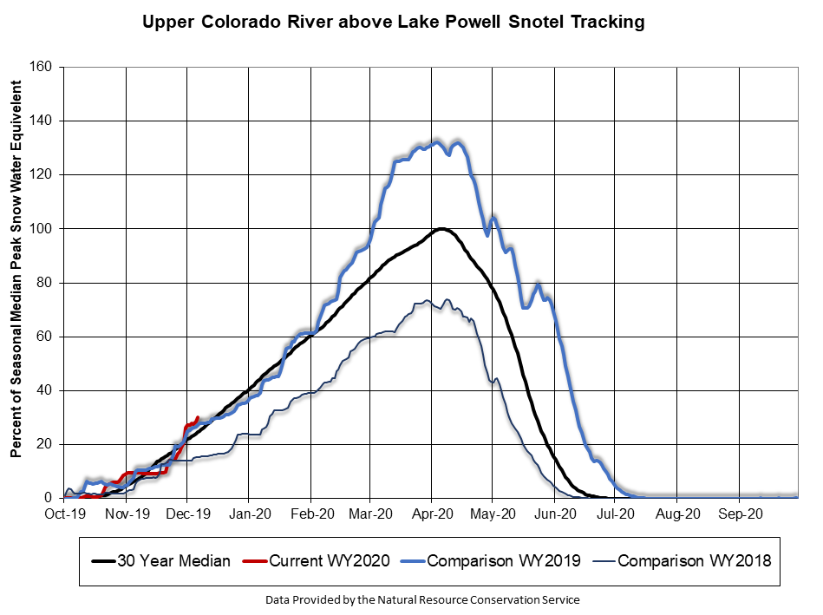
UC Basin Snowpack Accumulation
Notes:
129% above median, conditions similar to WY2019
Snowpack is significantly above WY2018 conditions at this same time
Forecasts have been decreasing since August, but current snow accumulation provides a buffer for WY2020 conditions

Slide 5
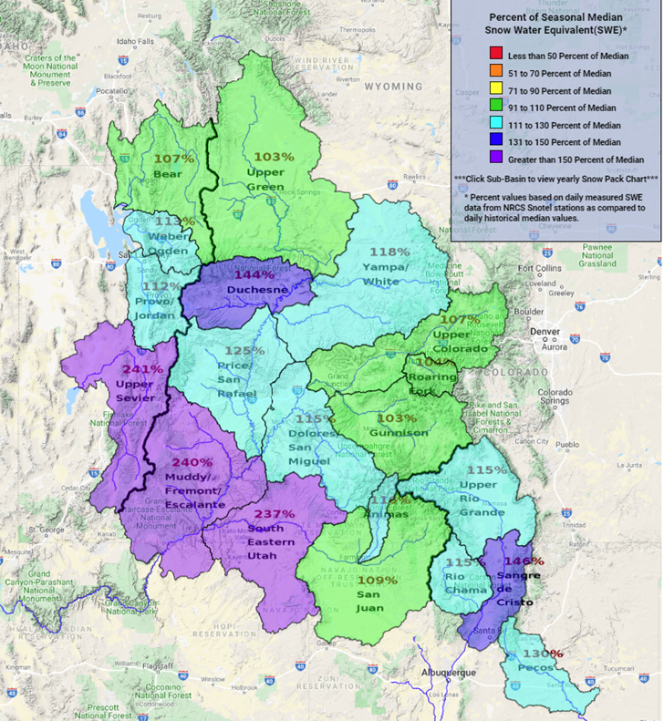
UC Basin Snowpack Accumulation

Slide 6
Safety of Dams
Evaluates and implements actions to resolve safety concerns at Reclamation dams
Steinaker Dam
Modification work to repair slope failure complete October 2019
Currently undergoing first fill monitoring
Notes:
We take great pride in our safety of dams program, which proactively evaluates and implements actions to resolve safety concerns
Success story: Steinaker Dam
-Slope failure repair went smoothly/according to plan and is now substantially complete
-First fill monitoring: no adverse performance issues observed
-First fill requirements may take multiple years depending on water availability, scheduled completion in FY2021
The safely operating Steinaker Dam:
-Benefits water consumers, recreational users
-Important feature of Central Utah Project

Slide 7
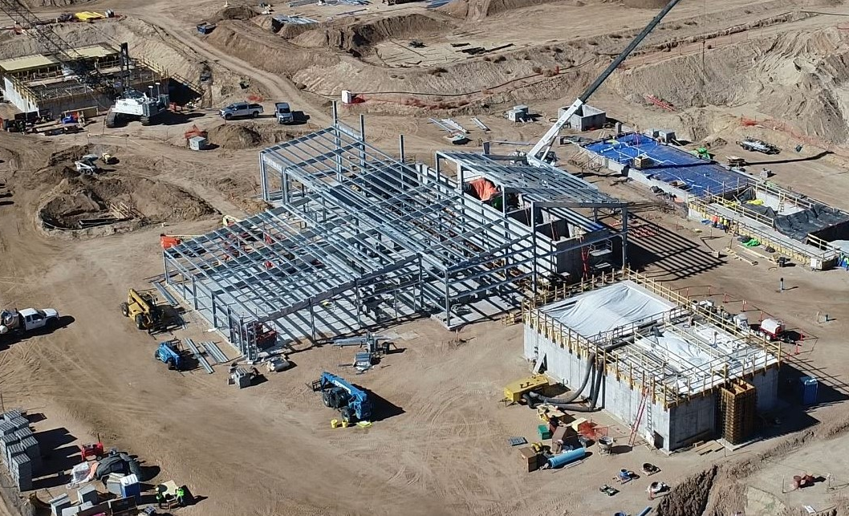
Indian Water
Rights Settlements
Navajo-Gallup Water Supply Project
Utah-Navajo Water Right Settlement
Notes:
Component of Navajo Nation’s water right settlement on San Juan River in New Mexico
Provide reliable municipal and industrial water
Spur economic development on Navajo Reservation
Cutter Lateral expects first water delivery in 2020
Four Corners Construction Office currently investigating alternative intake options on the San Juan
While this may delay project completion, in the end their efforts:
Potential to save $60million
Potentially reduce long-term O&M costs
Full project completion:
2 water treatment plants
300 miles of pipeline
19 pumping plants
End user: Eastern Navajo Nation, Southwestern Jicarilla Apache Nation, City of Gallup
Sponsors: Navajo Nation, Jicarilla Apache Nation, City of Gallup, State of New Mexico
Current construction cost estimate indexed to $1.195 billion at FY20 price level (Oct 2019 prices)

Slide 8
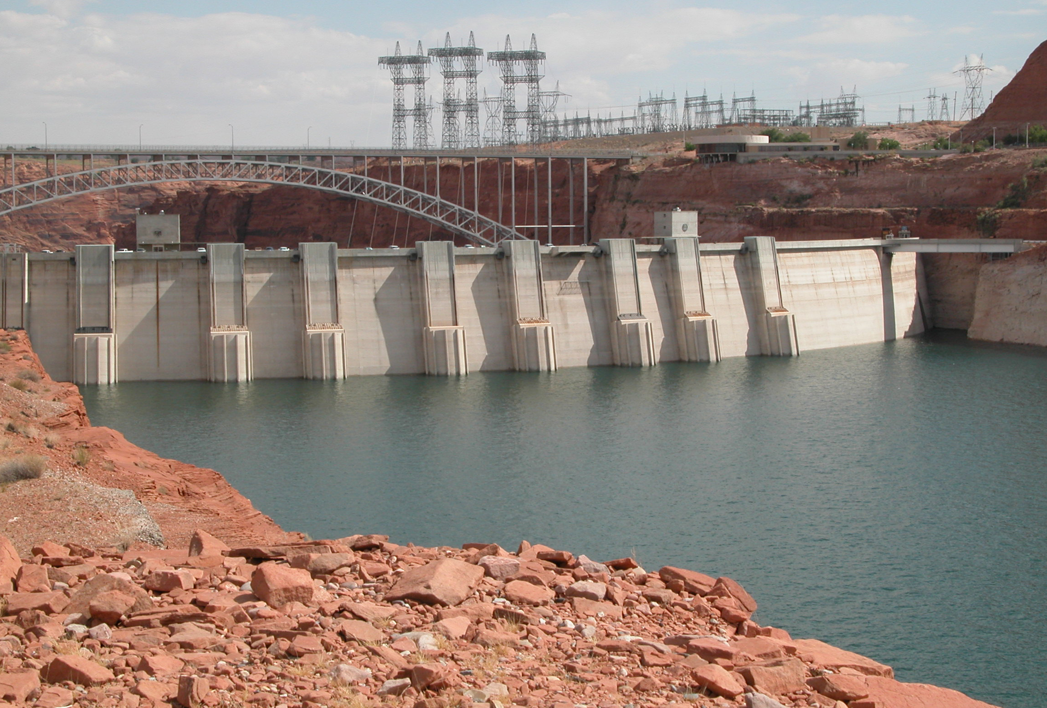
Glen Canyon Dam Adaptive Management Program
Interior’s Strategic Guidance Memo – August 2019
Provides policy direction to Adaptive Management Working Group consistent with administration priorities
Solicit new AMWG member nominees via the Federal Register
GCDAMP funding
LTEMP Litigation
Notes:
E.O. 13875: Improving Utility of Federal Advisory Committees (6/14/19)​
AMWG cleared DOI review in late October, can resume business as usual​
​
Policy direction from Secretary’s Designee (Assistant Secretary for Water & Science):​
Consider implications of other planning efforts like DCPs, Interim Guidelines review​
Focus on LTEMP​
Explore operational flexibility – improve hydropower resource​
Complete action items – update guidance docs, monitoring metrics​
​
AMWG Members ​
Will notify all outstanding nominees (~8) of their status before the end of the calendar year​
DOI decisions made, letters are in process​
The new notice will be issued as soon as outstanding notification letters have been issued​
Hope to fill the many (~17) vacant member and alternate positions by early to mid 2020 ​
​
LTEMP Litigation​
NGO lawsuit challenges 2016 LTEMP EIS and ROD​
three NGOs—Save the Colorado, Living Rivers, and Center for Biological Diversity​
Claim it failed to address climate change impacts to water supply & a wider range of alternatives, including tearing down Glen Canyon Dam​
Interior’s Office of the Solicitor is coordinating with DOJ on litigation schedule negotiations ​
The United States filed an Answer on Dec. 6. ​
We expect to know more about upcoming schedule before the end of December. ​
​

Slide 9
Lake Powell Pipeline
Project proposal from Utah Board of Water Resources
Interior designated Reclamation as lead federal agency for environmental review - October 2019
Notice of Intent to develop draft EIS published in Federal Register December 6, 2019
Opportunity for public comment on NOI, Draft EIS
Public scoping meetings in January 2020
Timeline for ROD signature is January 2021
Notes:
FERC was previously lead agency, hydropower elements of the project have been withdrawn and Reclamation is now NEPA lead
Multiple opportunities for public comment
NOI
Public scoping meetings: St. George, Kanab, Salt Lake City in January 2020 (dates posted to website)
Draft EIS (anticipate to publish in Federal Register May 2020)
Cooperating/coordinating agencies: BLM, USFWS, BIA, NPS

Slide 10
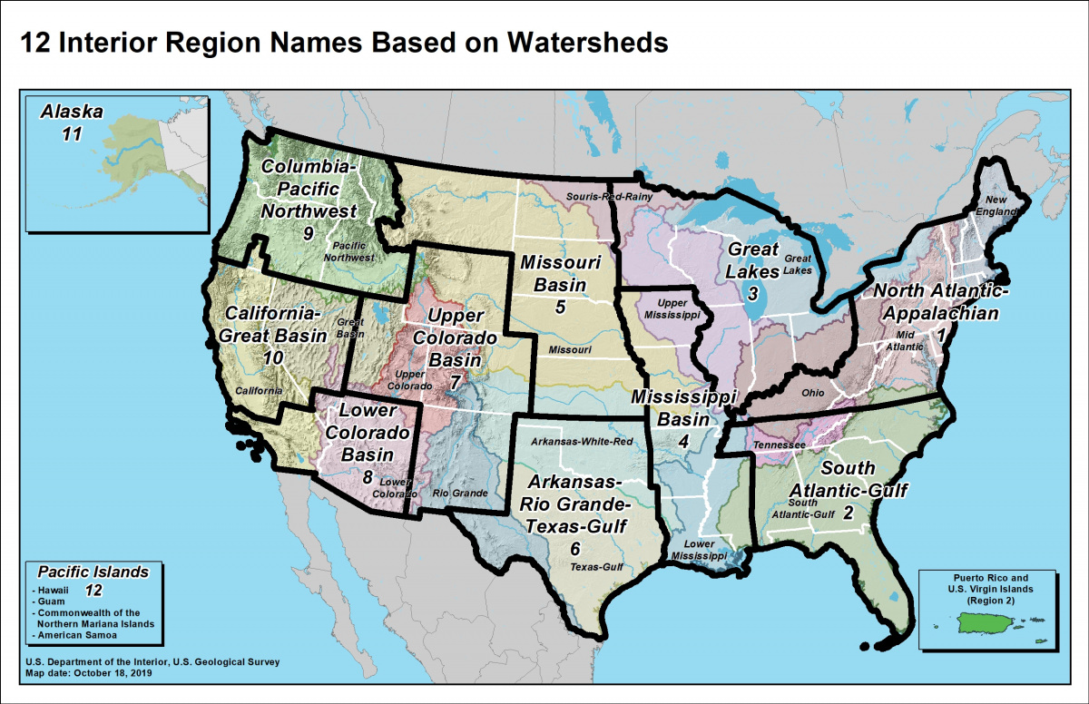
Department of the Interior Reorganization
Interior Region 7 – Upper Colorado Basin
Utah, Wyoming, Colorado, New Mexico
Recommendation to Commissioner
Wyoming and Eastern Colorado Area offices
Notes:
DOI’s overall goal is improved communication and efficiency across DOI bureaus
Region boundaries based on watersheds, generally drawn along state lines to simplify coordination with external partners (like states)
We are now part of Unified Interior Region 7 – Upper Colorado Basin which includes all of Utah, Wyoming, Colorado and New Mexico
Region 7 Goals
Formed the Regional Executive Council for Interior Region 7
Fed Agency leadership in the region working together
Regular communication with Alan Mikkelsen (Field Special Assistant)
We’ve drafted a recommendation to the Commissioner regarding the management and operation of area/field offices that previously fell under the purview of a different region

Slide 11
Miscellaneous Updates
Flaming Gorge Working Group
Title Transfer Initiatives
Upper Green River Basin
Fontanelle Reservoir
Notes:
FLAMING GORGE WORKING GROUP:
Provo AO (on behalf of UC Basin) scheduled additional session to report back to group on how their input was applied to the release plan for the year
Striving for responsive and transparent communication
TITLE TRANSFER INITIATIVES:
We are open to working with interested parties
- Uinta Basin Replacement Project
Emery County Project Title Transfer
UPPER GREEN RIVER BASIN:
First phase of piping of Eden Canal
Continue NEPA compliance progress in proposed raise of operating level of Big Sandy Dam
FONTANELLE RESERVOIR
Continue engagement with the State of Wyoming on propose riprap project to increase operational capacity of the reservoir

