Slide 1

UCRC demand management investigations Request for proposal s (RFP)
Q/A Webinar
Friday, November 22nd, 2019 - 10:00 a.m. MT
Webinar link: https://zoom.us/j/873701193
Meeting ID: 873 701 193
Dial by your location
+1 720 707 2699 US (Denver)
+1 646 558 8656 US (New York)
*Webinar was not recorded due to technical difficulties.*
Sara Larsen, PE, Deputy Director and Amy Haas, Executive Director of UCRC

Slide 2
Webinar agenda
Power issues at UCRC building – might have an outage.
Brief overview of the UCRC’s Demand Management Investigations Grant
Communications Protocol
Basic Qualifications Section of the RFP
Scope of Work Section of the RFP
Other RFP materials
Reminders and Suggestions
Questions and Answers

Slide 3
UCRC Demand management investigations grant
This grant will build on work conducted by UCRC and Reclamation with the System Conservation Pilot Program (SCPP) and the Upper Basin Drought Contingency Plan (DCP).
DCP allows for the potential creation of a Demand Management Program and for use of Demand Management Storage in CRSPA Initial Units (Lake Powell, Aspinall, Flaming Gorge, and Navajo Reservoirs).
UCRC and the Demand Management Committee (DMC) (a subset of the Upper Division States’ legal and technical advisors) have an interest in investigating the feasibility of Demand Management in the Upper Basin.

Slide 4
UCRC Demand management investigations grant
RFP and the Scope of Work were developed by UCRC and the DMC members
  Specific grant activities will be prioritized depending on the Contractor(s) awarded
  Specific grant activities will then proceed with agreed upon work orders, etc. from the DMC through the UCRC staff to the Contractor, and vice-versa for deliverables.
    In the RFP language, you’ll see “In particular, the Contractor, at the direction of the UCRC Demand Management Committee and through UCRC staff, will:…” repeated through the SOW.
Ensures that all grant activities are in sync and alignment with intrastate demand management efforts

Slide 5
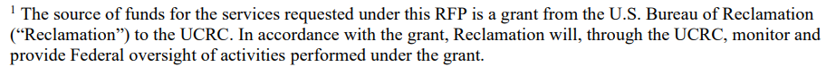
UCRC Demand management investigations grant
Grant period is from the award (Notice to Proceed, tentatively early spring in 2020 to Sept. 19th, 2022 – ~2.5 years to conduct grant activities.
Reclamation has provided UCRC with the funds for these investigatory activities.
Grant is for funding of up to $800,000, which does include some costs for UCRC to administer the grant.

Slide 6
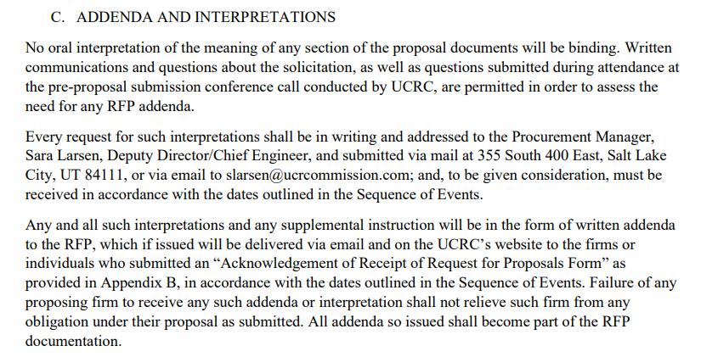
Written Questions about the rfp…
The UCRC is committed to having a competitive, open procurement process.
All interested parties must have the same set of information regarding this solicitation.
The deadline to submit written questions is 11/29/2019.
UCRC’s deadline to respond to written questions is 12/6/2019.

Slide 7
Your webinar questions…
For this webinar, please hold your questions until the end of the presentation. Please state your name first when asking a question.
Straight-forward questions that concern RFP and procurement procedures can be answered on the call
Questions concerning an interpretation of the Scope of Work may have to be referred to the Demand Management Committee for review and responded to in writing.
All questions, both answered on the webinar and those that will be referred to the Demand Management Committee, will be compiled as RFP addenda and distributed to the POC listed on your Appendix B form.
These will also be added to the bottom of the UCRC RFP webpage as addenda.

Slide 8
Basic Qualifications Section of the RFP
“Professional engineers and/or attorneys shall be licensed in one of the [Upper Division – NM, UT, WY, CO] States and shall indicate areas of discipline or emphasis.”
1) Legal Analyses: Western water law research and analysis
2) Technical Analyses:
  Water resource hydrology, reservoir storage, and river/streamflow routing and modeling,
  Consumptive water use monitoring, estimation, verification and accounting techniques, and
  Water banking, accounting, monitoring, and conveyance principles and methods
3) Economic Analyses: Water markets and cost effectiveness of demand management (review Task 3 items below), administrative costs, socioeconomic and community impacts of demand management, long-term funding for demand management
4) Stakeholder Facilitation and Outreach: Ability to convene, facilitate, and coordinate discussion sessions and outreach with key stakeholders in each state or all states, the State advisors, and UCRC staff

Slide 9
Basic Qualifications Section of the RFP
For this RFP, we have FOUR Core Proficiencies: Legal, Technical, Economic Analyses, and Stakeholder Facilitation and Outreach – A single Offeror may indicate their interest in one or more of these categories.
“Offerors must state in their cover letter and proposal which set of the above qualifications (one or more) they would like to be considered under for this procurement. Offerors shall include in their proposal a separate estimated budget for expected costs over the project period for any or all categories listed above for which they would like to be considered using the budget form provided in Appendix A”
  Enables comparison of “apples to apples” for entities that apply to do one or a subset of the categories listed above.
Another configuration is for one proposal to be submitted by a “team” of multiple organizations (multiple Offerors, with one proposal covering multiple proficiencies).
“A multiple source award may be made when awards to two or more Offerors are necessary to meet adequate delivery of services. If two or more awards are made, some coordination, overseen and conducted by UCRC staff and/or the Demand Management Committee, may be necessary and should be acceptable to the Offerors.”

Slide 10
Basic Qualifications Section of the RFP
“It is essential that Offerors clearly demonstrate they possess the necessary expertise and qualifications for the types of services and tasks described in the Scope of Work.”
“This includes but is not limited to: specialized legal research and/or technical competence; capacity and capability to perform the work; positive references regarding work performed for prior clients, past record of performance with such factors as control of costs, quality of work, and the ability to consistently meet scheduled milestones and deliverable deadlines.”

Slide 11
Scope of work/RFP Walkthrough
Visit the RFP to review Tasks 1-6 and other RFP sections

Slide 12
Reminders and suggestions
Last day to submit written questions is 11/29/2019.
For proposal submission, please use the format prescribed in Section VI. SUBMITTAL REQUIREMENTS for proposal submission (order of documents, etc.).
Please make clear which of the four competencies you are applying for and include a separate budget table for each.
Please adhere to the communications protocol laid out in the RFP. For interpretive questions that need review by the DMC we will do our best to give you a quick turnaround.
Please send your proposal to arrive via email or at the UCRC office by December 20th, 3:00p.m. MT.
  Don’t wait until the last minute. Try to send earlier in case of delivery failure, etc.
  I will confirm receipt with your POC on Appendix B. The Offeror and date/time of arrival will also be posted to the RFP webpage.

Slide 13
Questions and Answers
Will the Powerpoint be made available? Yes, this Powerpoint will be made available as part of the RFP addenda.
When you say “other tasks” [as assigned by the DMC in the SOW] that are open, how are we supposed to budget for them?
  When drawing up the proposed budget, you may include a line item for “other tasks” as assigned by the DMC. The DMC will tailor work orders for the awarded Contractor(s’) budget.
Do you have a preference for emailed proposals versus hard-copy?
  Our preference is for email, but feel free to send prior work as a packet of materials if that is preferred.
Can you discuss who will be on the selection committee?
  No.
Do you have a copy of a draft agreement between UCRC and Contractor(s)?
  The contract will be similar to the General Terms &Conditions in the RFP, but that agreement hasn’t been developed yet.

Slide 14
Questions and Answers
Please confirm 1,000 points for each evaluation category.
  Yes, 1,000 points for each evaluation category. Final scoring will be a percentage based on actual score/potential score.
Confirm 10 pages total, even if applying for multiple categories.
  Yes, please stay with the 10-page limit for narrative sections, even if applying for multiple categories.
Can an entity or individual propose as a part of a team and as a single proposer for one qualification criteria?
  Yes, you can propose as a team for one or more qualification criteria.

Slide 15
Questions and Answers
If the source of funding is a BOR grant, are the contractors allowed to have profit (fees) on the staff rates?
  Yes, you may have a “billing rate” for staff that includes profit.
Is it your intent to hire only one contractor for each category, regardless of whether or not they are on a team?
  No, will probably have multiple categories for some contractors, and that’s okay. We will review where overlap is in the submissions.
Clarification on question above: Is it ok to propose both as a part of a team and as an individual contractor?
  It’s okay to propose as both part of a team and individually, but may be difficult to do, as you would be competing with your other proposal.

Slide 16
Questions and Answers
We noticed that the RFP states that the UCRC may make multiple awards, and we were hoping you could provide more information on what this might look like. For example, is the UCRC's goal is to have one contractor oversee the entire process/set of questions and then work with sub-contractors on specifics?
  UCRC welcomes proposals from firms/entities that may propose to subcontract out portions of the work, if needed. There is a budget line item for “Subrecipient Contracts.” We also anticipate proposals from individual firms/entities, and “team” proposals. Please see Slide #9 for info. on coordination between multiple Contractors.
If the UCRC is considering working with multiple contractors, is the UCRC is willing to accept applications for only specific portions of the RFP?
  Yes. Please see slide #9 for the four core proficiencies that we would like contractors/entities to apply for (legal, technical, economic, and outreach proficiencies), as opposed to applying for particular SOW tasks.

Slide 17
Questions and Answers
Does the UCRC envision demo projects fitting in to the RFP?
  No. The SOW is directed toward legal, technical, economic analyses, and some outreach/stakeholder engagement activities only. It is hoped that this work would inform such a pilot or additional demonstration projects, or a wider demand management program.
Is this solicitation is targeted towards consultants or would other entities be appropriate to respond?
  The UCRC is committed to a highly competitive, open procurement for this RFP and wishes to solicit proposals from any and all Offerors that have the related knowledge, skills, and experience described in the header and Scope of Work sections in the RFP. As such, we welcome proposals from different types of entities as well as private consultants.

